Slide 1
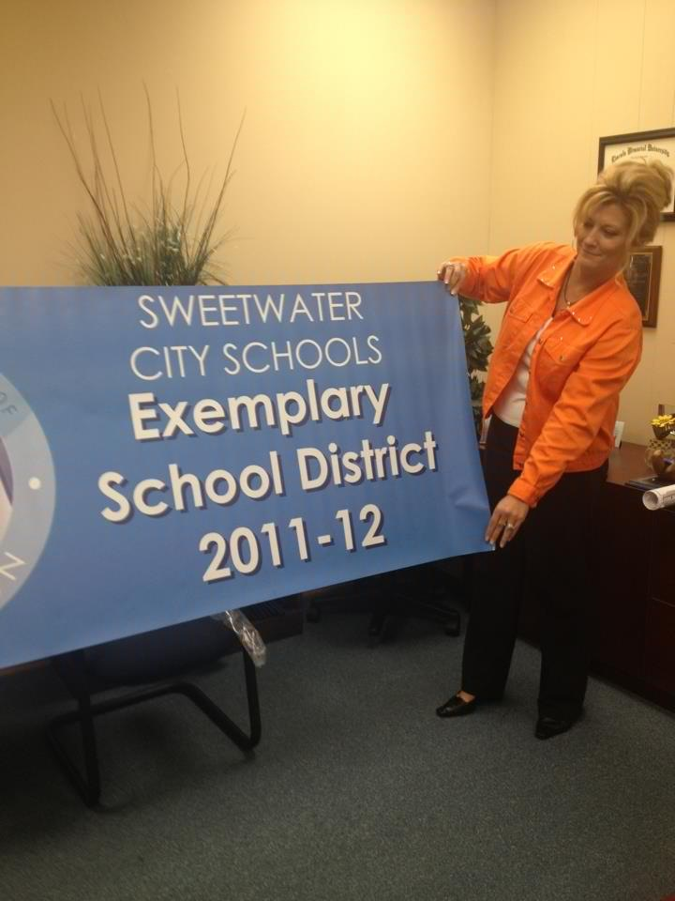
The Interactive Classroom

Slide 2
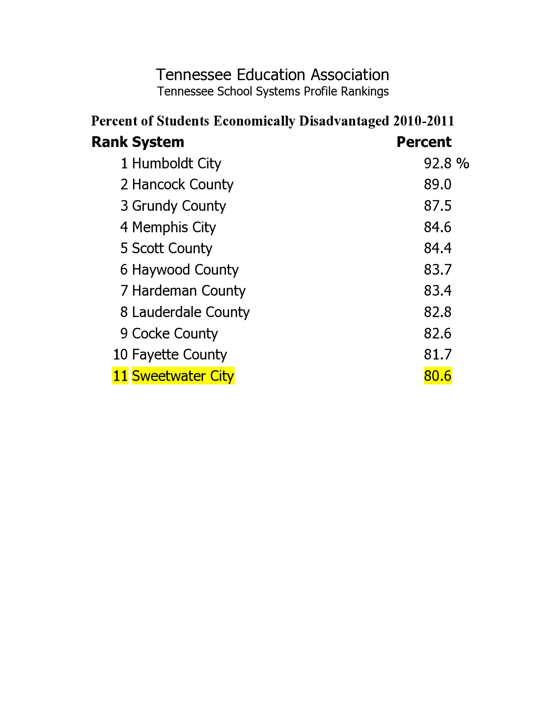

Slide 3
SCS Administration
Dr. Melanie Miller
Director of Schools
Melanie.miller@scstn.net
Dr. Larry Stein
Supervisor of Instruction
Larry.stein@scstn.net

Slide 4
Presenters
Melissa Purdy – Instructional Coach
Julia King- 8th Grade Language Arts
Tonya Wallis- 5th Grade Teacher
Karen Sadikoff-Instructional Coach/Reading Intervention

Slide 5
In the Beginning…

Slide 6
The Decision
#1 Focus: Teamwork
“Coming together is a beginning. Keeping together is progress. Working together is success.”
Henry Ford

Slide 7
Data Driven Instruction
System-wide Data Teams created
Meet every 3 weeks ( after common assessments)
Analyze fresh academic data & non-academic data

Slide 8
Data Used
1. TCAP Assessment
2. Discovery Education Formative Assessment
3. School Created Formative Assessment (based off pacing guides)
4. School Created Benchmarks
5. 6 Questions standards-based quizzes

Slide 9
Standards Based Grading
6 Question Quizzes based on a single standard
Score:
1 = 93 (Advanced)
2 = 86 (Proficient)
3 = 75 (Non-Proficient)
4 = 68 (NP)
5 = 60 (NP)
6 = 50 (NP)

Slide 10
Our Game Plan
AAA-Intervention- “bubble kids”
ICU-Intervention-immediate/dropbox
Classworks computer Program
Tutoring
Productive Practices
Blitz
Implementing “Best Practices”
iPads in Education

Slide 11
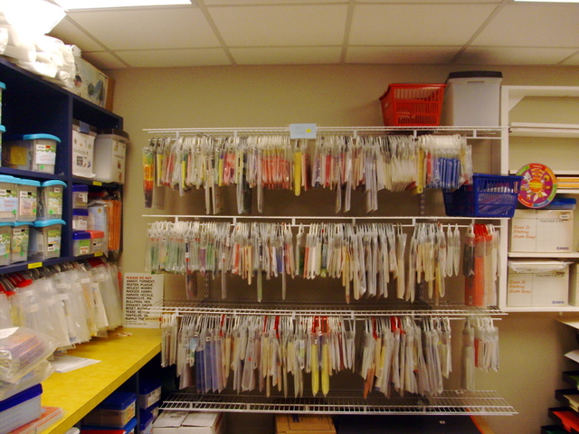
Productive Practices SES Utilizes to Promote Performance
Productive Practices to Promote Performance
Karen Sadikoff
karen.sadikoff@scstn.net

Slide 12
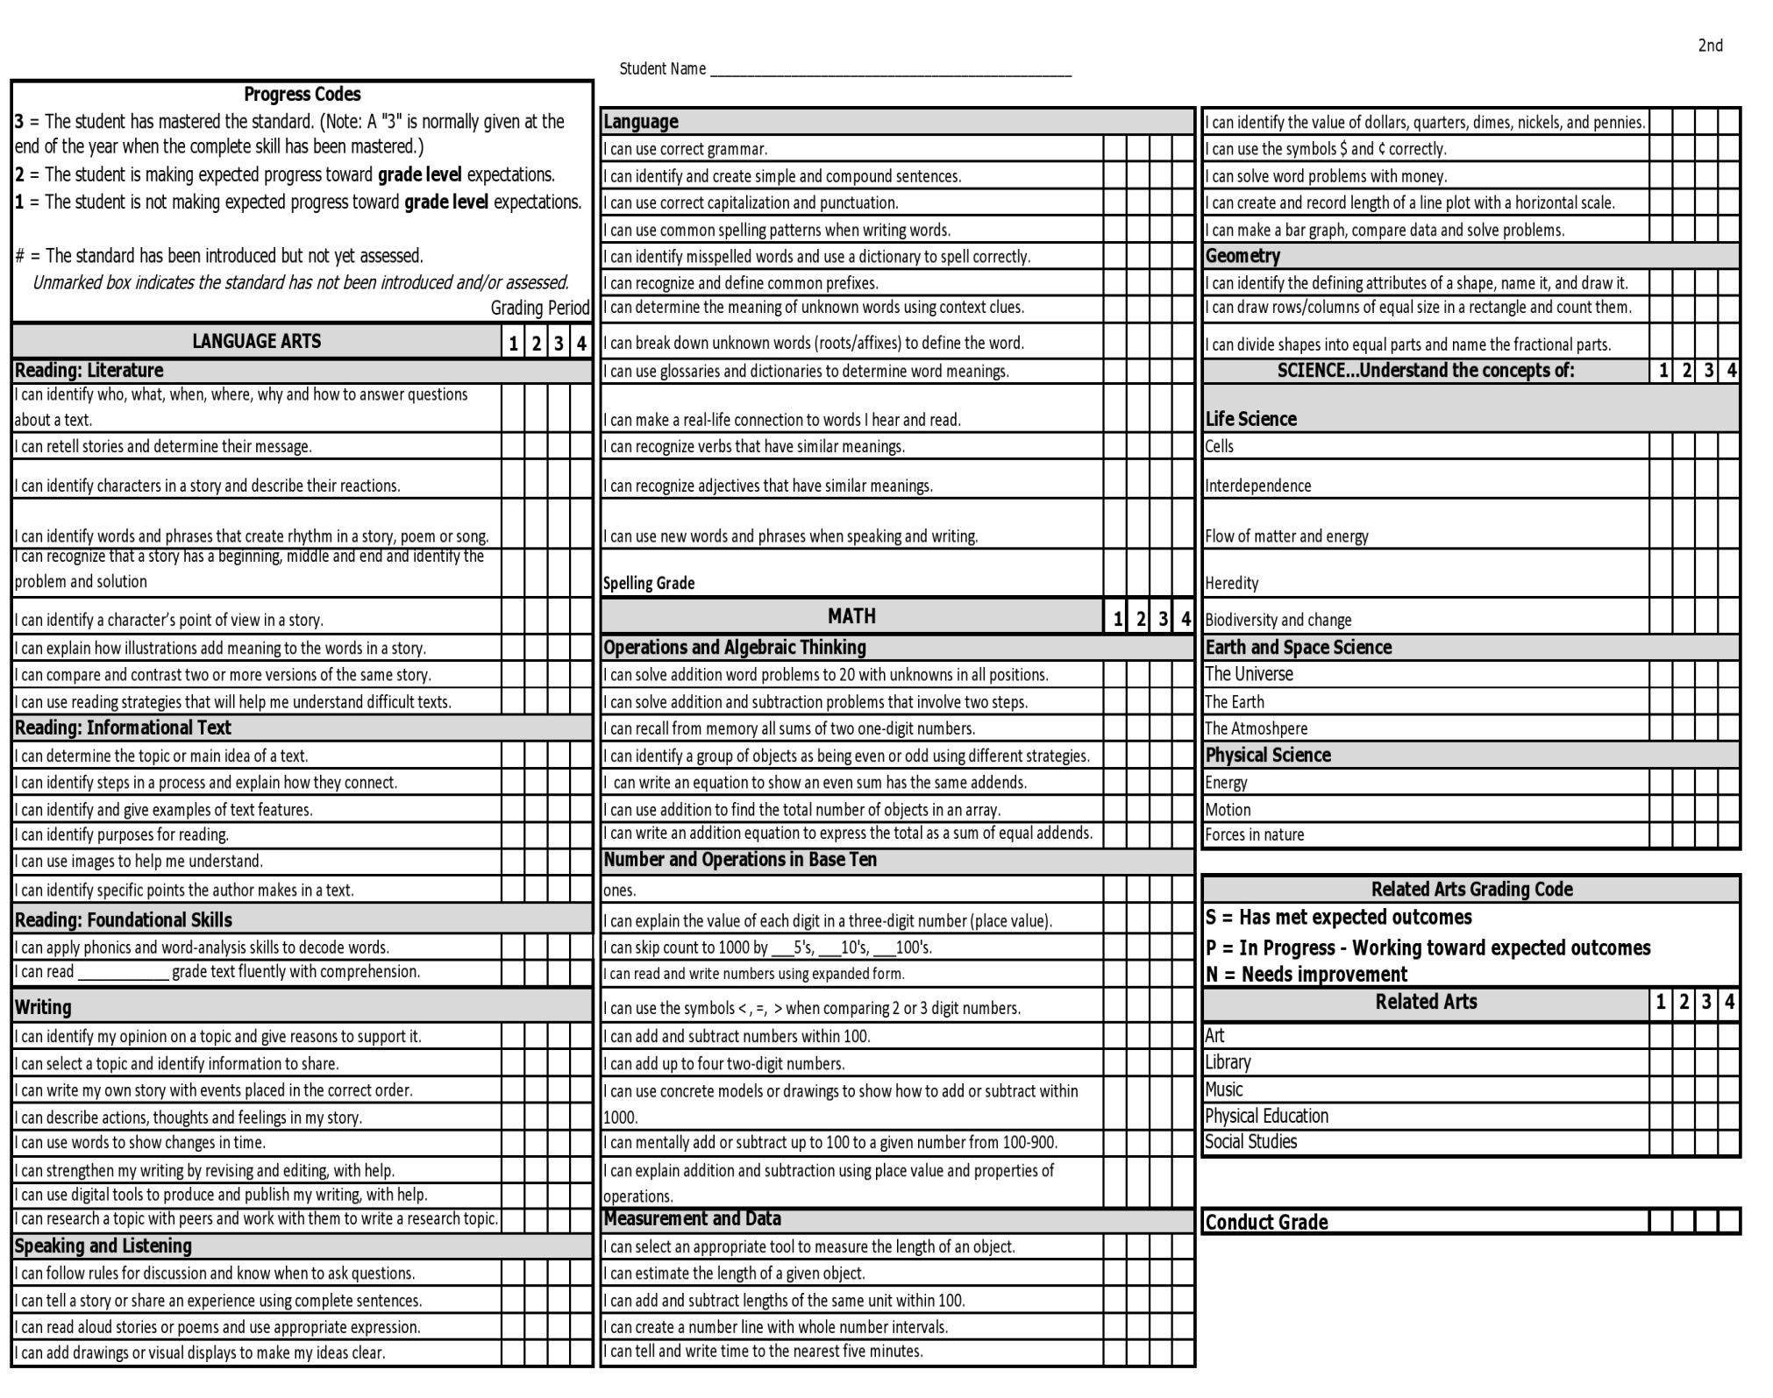

Slide 13
Prime Time – Every minute counts!
Endless hours are spent by the principal and staff during the summer to prepare a schedule that guards instructional time and utilizes special staff (Sp. Ed., ELL, music, library, P.E., intervention, resource classes)
Morning reading tutoring – 7:00-7:45 A.M. daily
Announcements are made before 8:00. Instruction begins at 8:00.
No morning recess – Students have a snack while they work.
PLCs occur during the school day and meet weekly between 7:30-8:30 A.M.
(Tuesday – 3rd grade and Wednesday – 4th grade)

Slide 14
PLCs
Always have a purposeful agenda – Minutes from PLCs go to the principal after meeting.
Include topics such as pacing guide, instructional strategies, analyzing data from common assessments and benchmarks
Incorporate teacher led mini sessions on topics such as Promethean training, how to use Discovery Education resources, CRA practice, reading comprehension strategies

Slide 15
Personnel
Good to Great , by Jim Collins
"We expected that good-to-great leaders would begin by setting a new vision and strategy. We found instead that they FIRST got the right people on the bus, the wrong people off the bus, and the right people in the right seats -- and THEN they figured out where to drive it. The old adage "People are your most important asset" turns out to be wrong. People are NOT your most important asset. The RIGHT people are."

Slide 16
Personnel
Highly effective Principal-leader & facilitator
Teachers work in teams-three 3rd grade/two 4th grade
Music Enrichment
The “Put Up Tree” where students are recognized who exhibit great behavior (Counselor)
Principal’s “Bee” Party for exemplary students
School-wide Positive Behavior Support – Students work on being ready, responsible, and respectful. All staff is involved in this plan.
2 x 10 – Adult mentors spend 2 minutes each day for the first 10 days to help at risk students begin the school year on the right foot.
Check In/Check Out for Tier 3 children – They check in at the beginning of each day with an adult and check out at the end of each day with an adult each day.

Slide 17
Parental Involvement
Traditional practices-Grandparents Day, scheduled evening conferences (schoolwide), Open House, Fall Festivals, Parades, Musical Programs
New Practices- Frequent, ongoing conferences with teachers, coach, and intervention teachers
Teachers make weekly contact with parents
Conferences are data driven and provide parents with specific skills students need additional help with.
Techno Tuesdays
Parent Reading Night

Slide 18
Professional Development
P. D. is ongoing throughout the school year through after school mini sessions and during plc’s.
P. D. is frequently on site.
P. D. is designed specifically to meet the needs of each grade level.
P. D. often includes book studies such as The Daily Five, Strategies That Work, Literacy Work Stations, The Next Step in Guided Reading with time allowed to prepare and implement these practices.
P.D. is led by instructional coaches and teachers.

Slide 19
Purposeful, Engaging Tasks
We know students learn best by doing.
We know that using Bloom’s Taxonomy as a guide to selecting our activities increases the level of student learning.
Let’s take a look at pictures of student created activities that promote skill mastery.

Slide 20
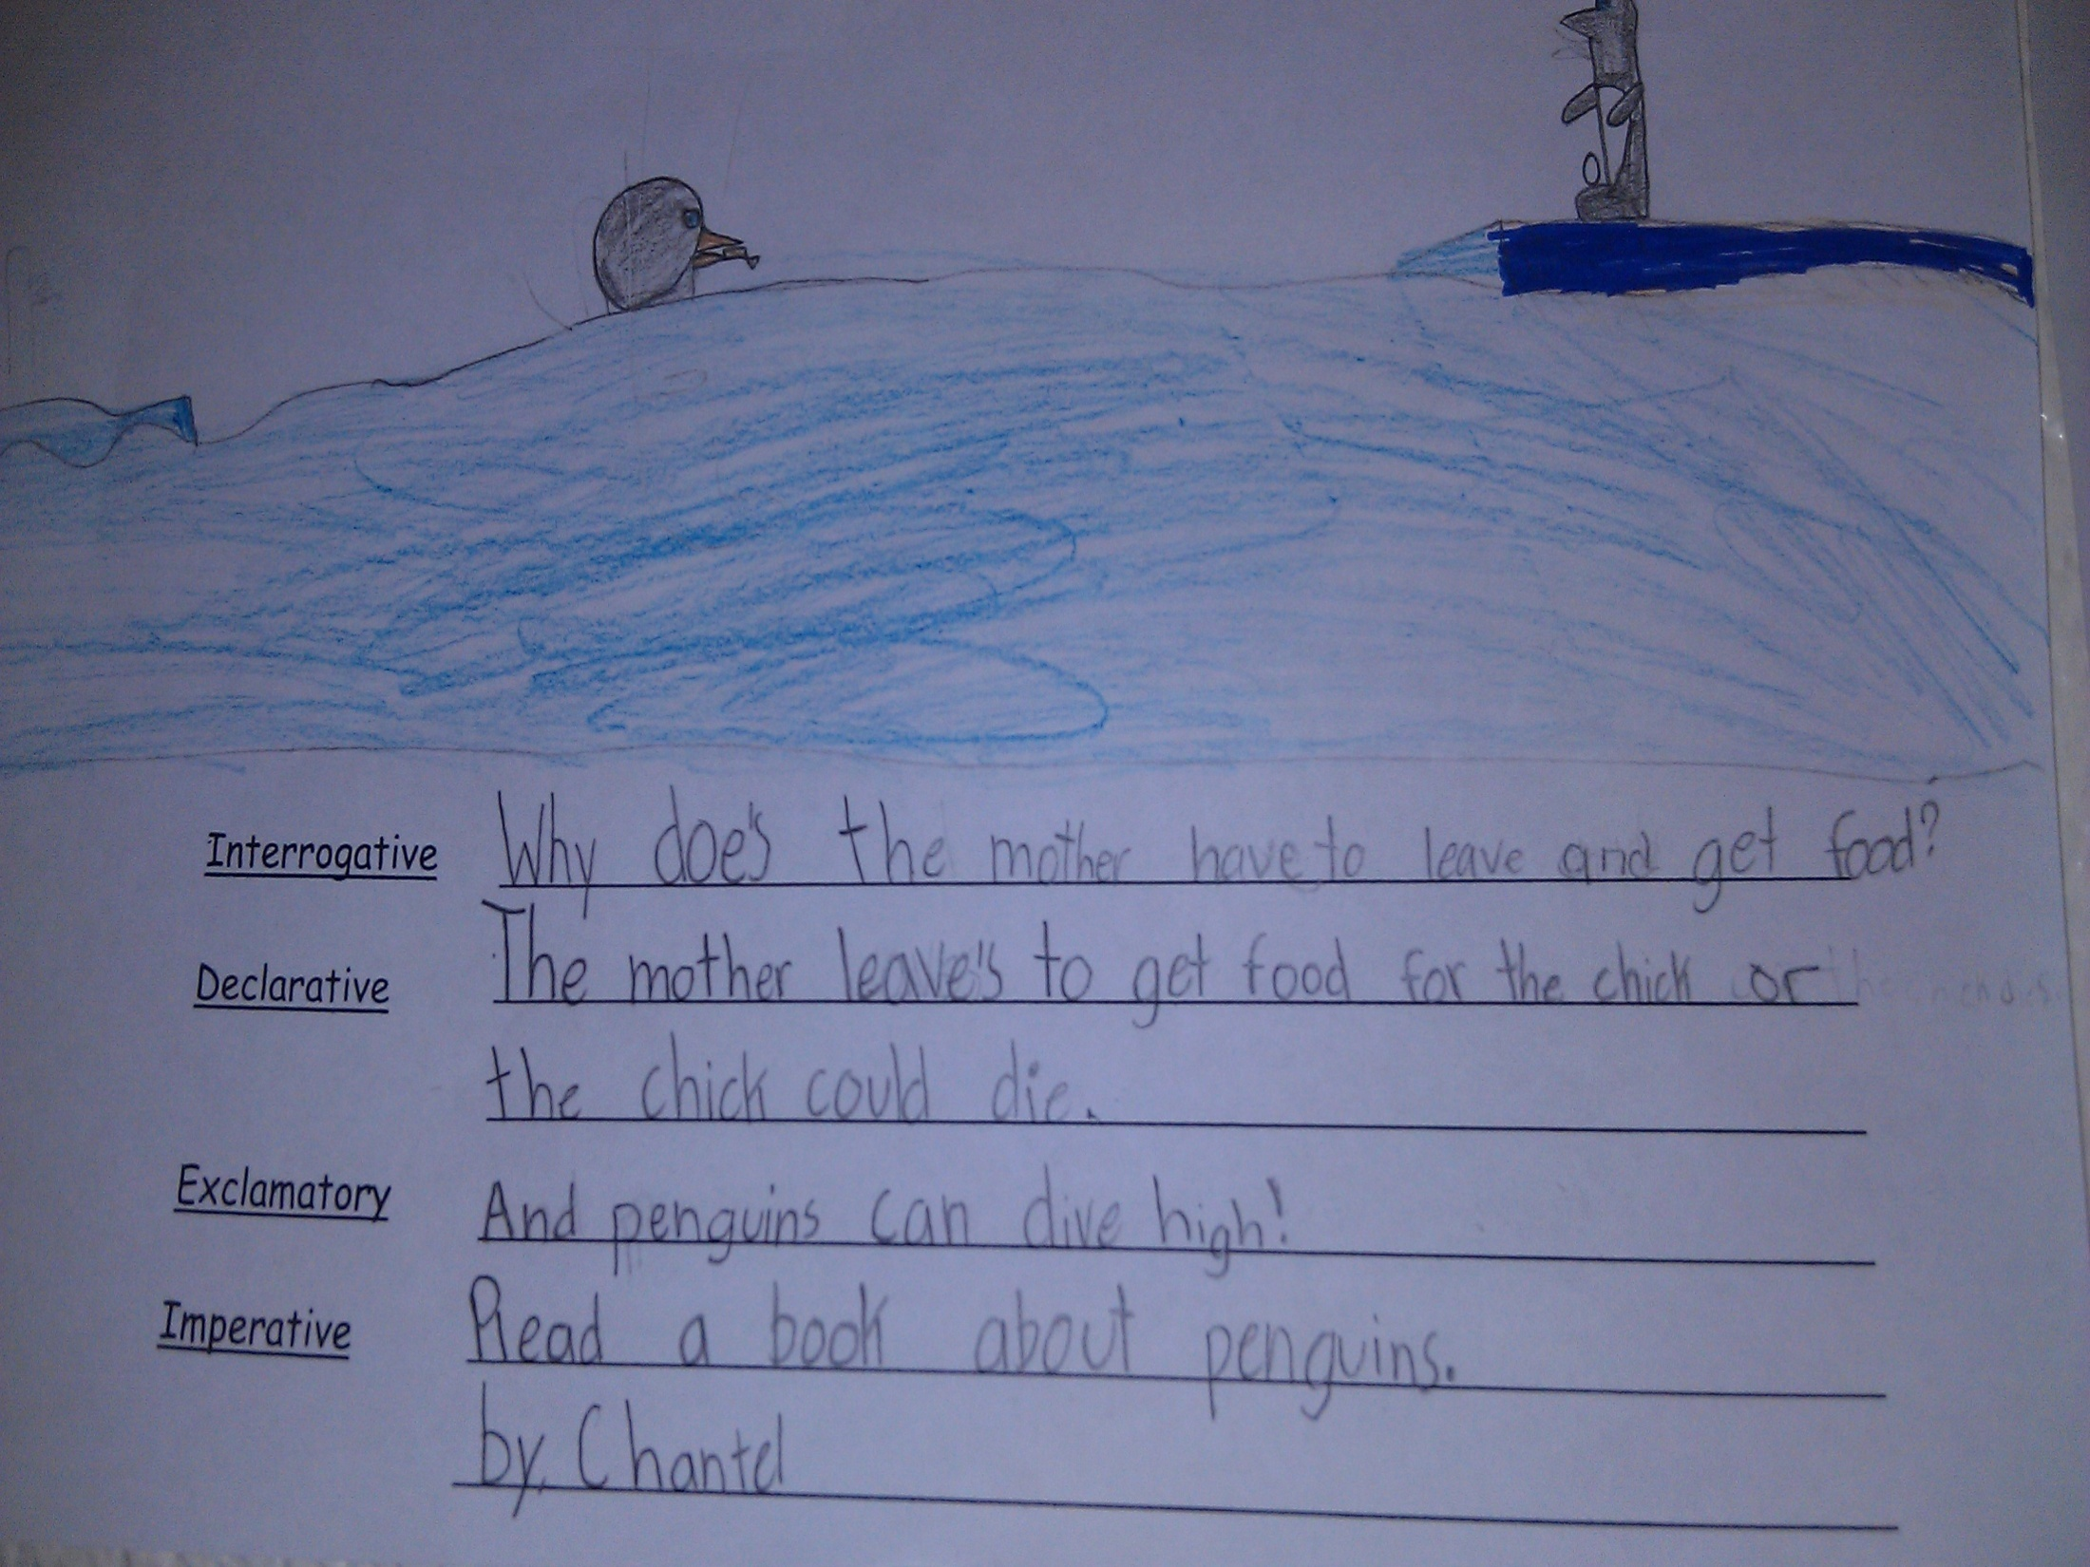

Slide 21
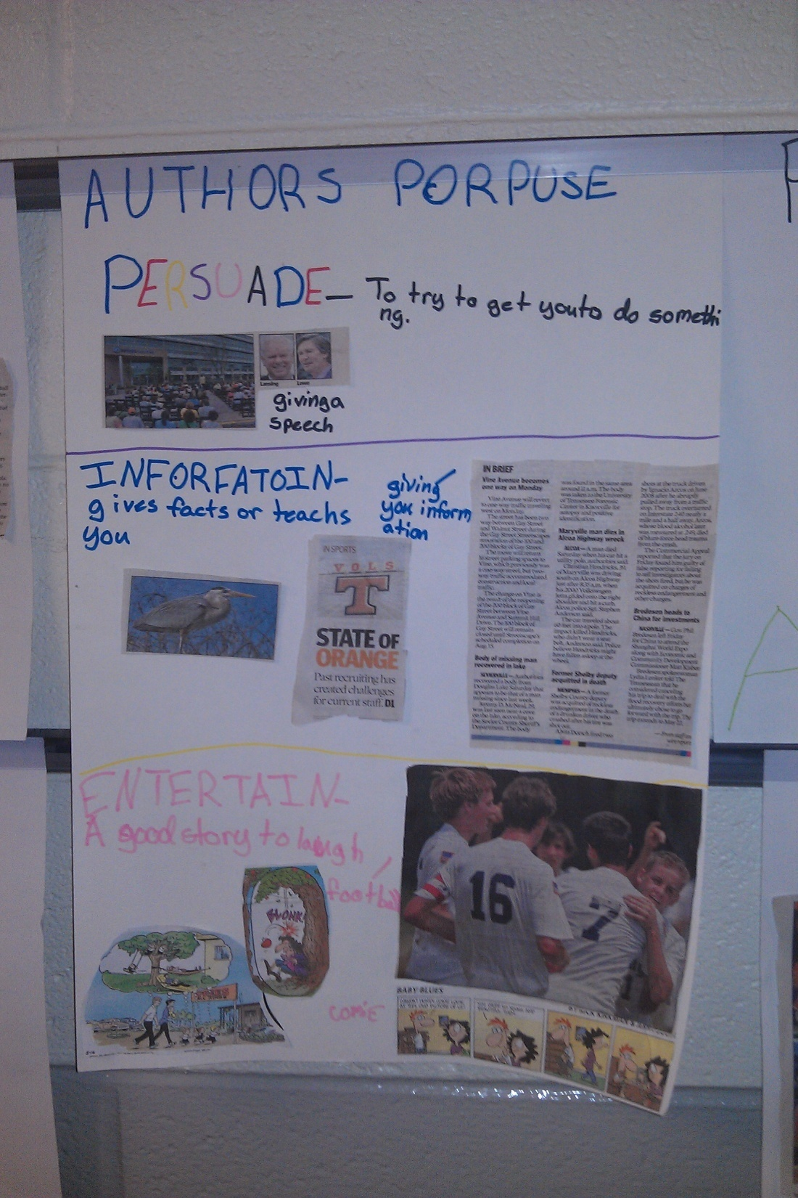
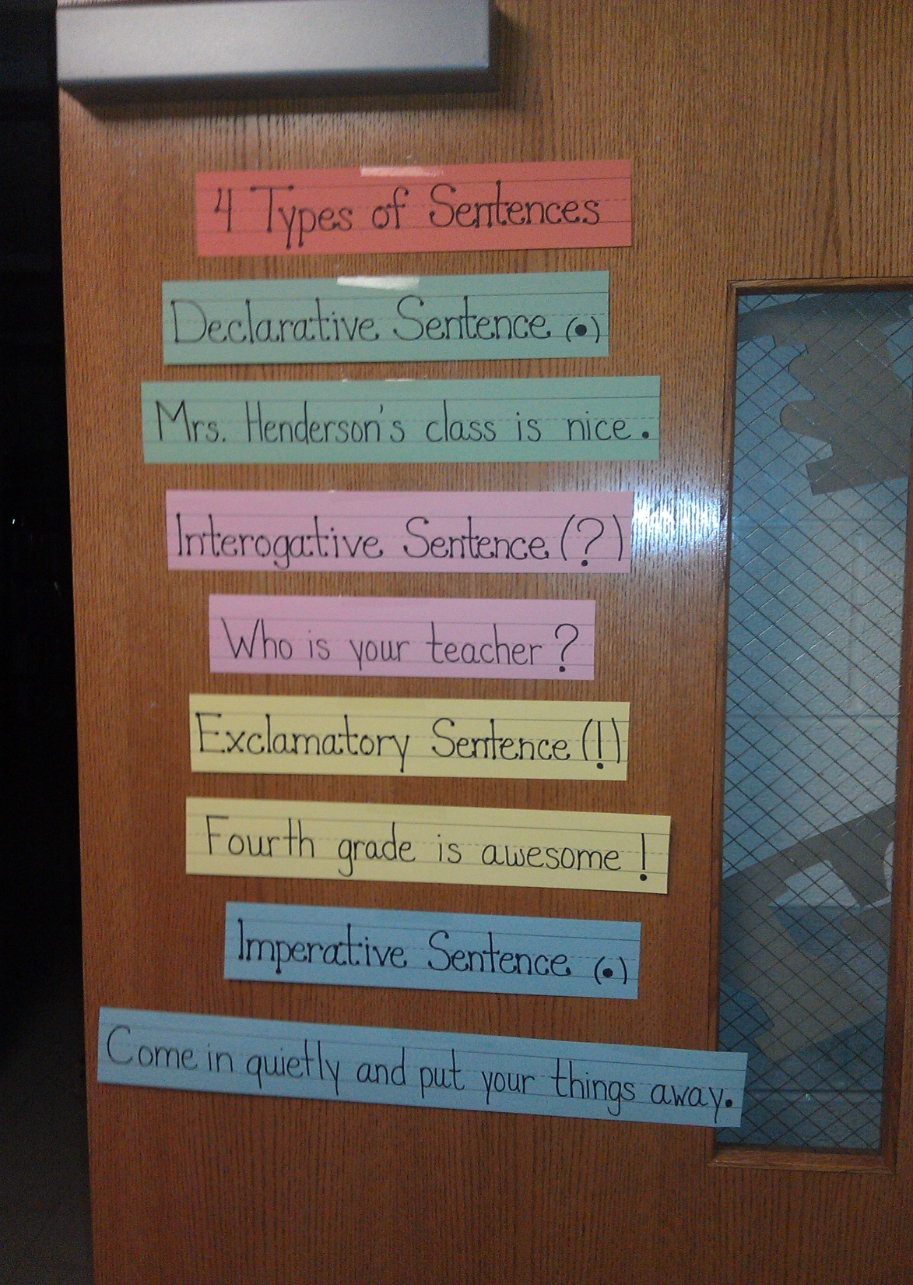

Slide 22
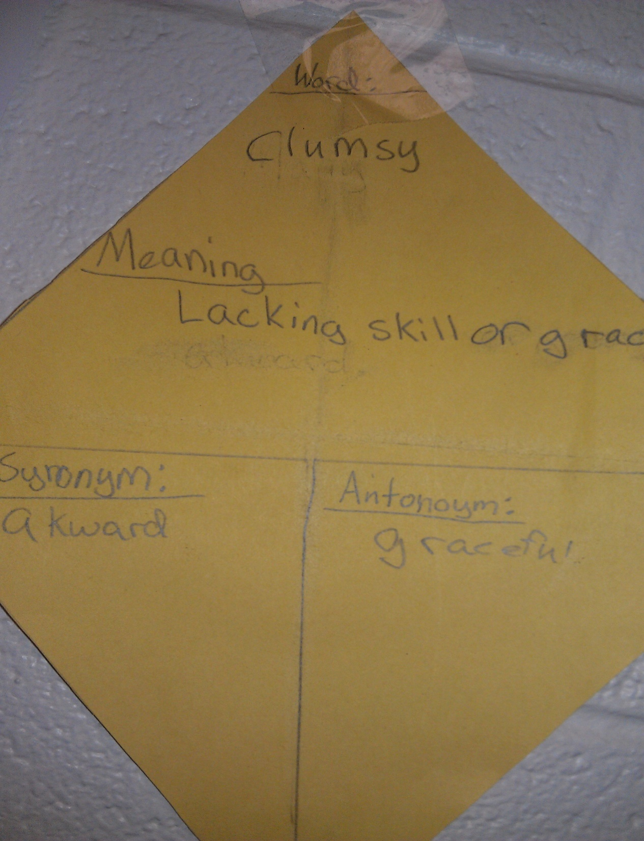

Slide 23
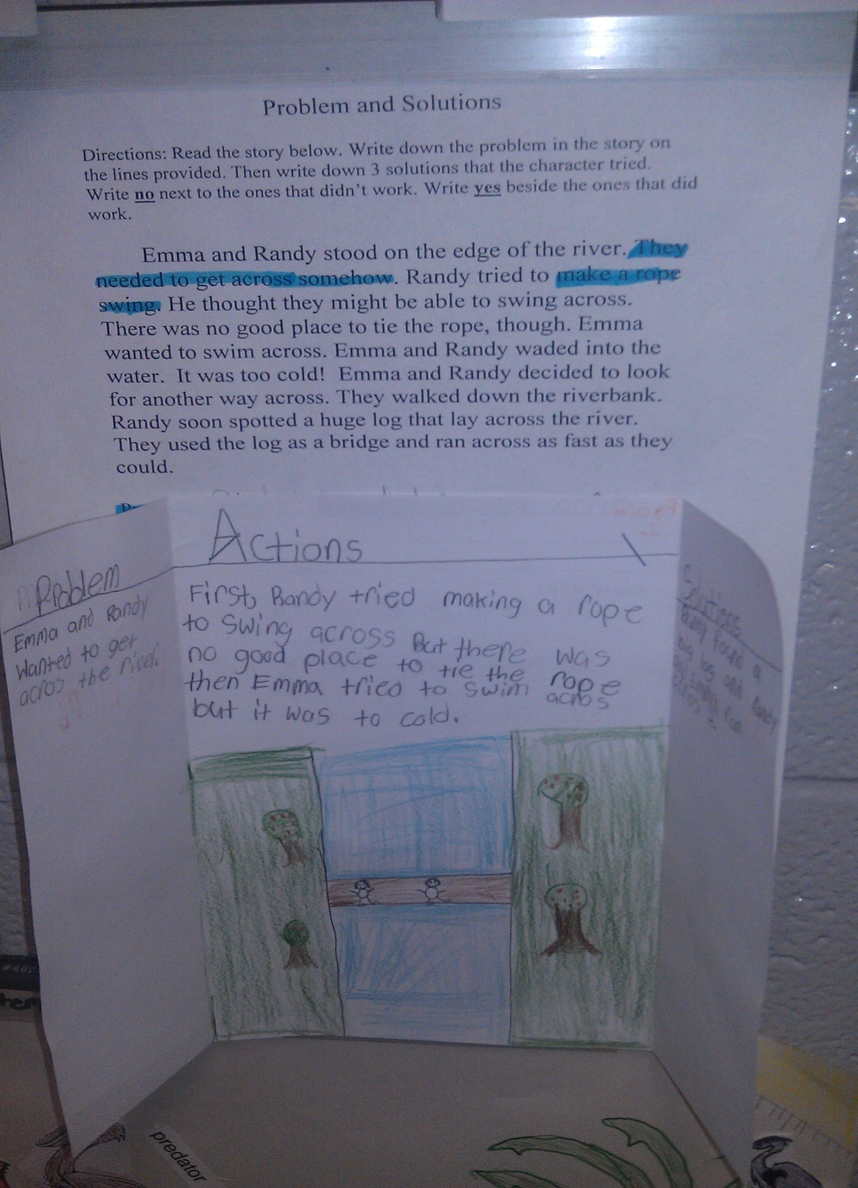

Slide 25
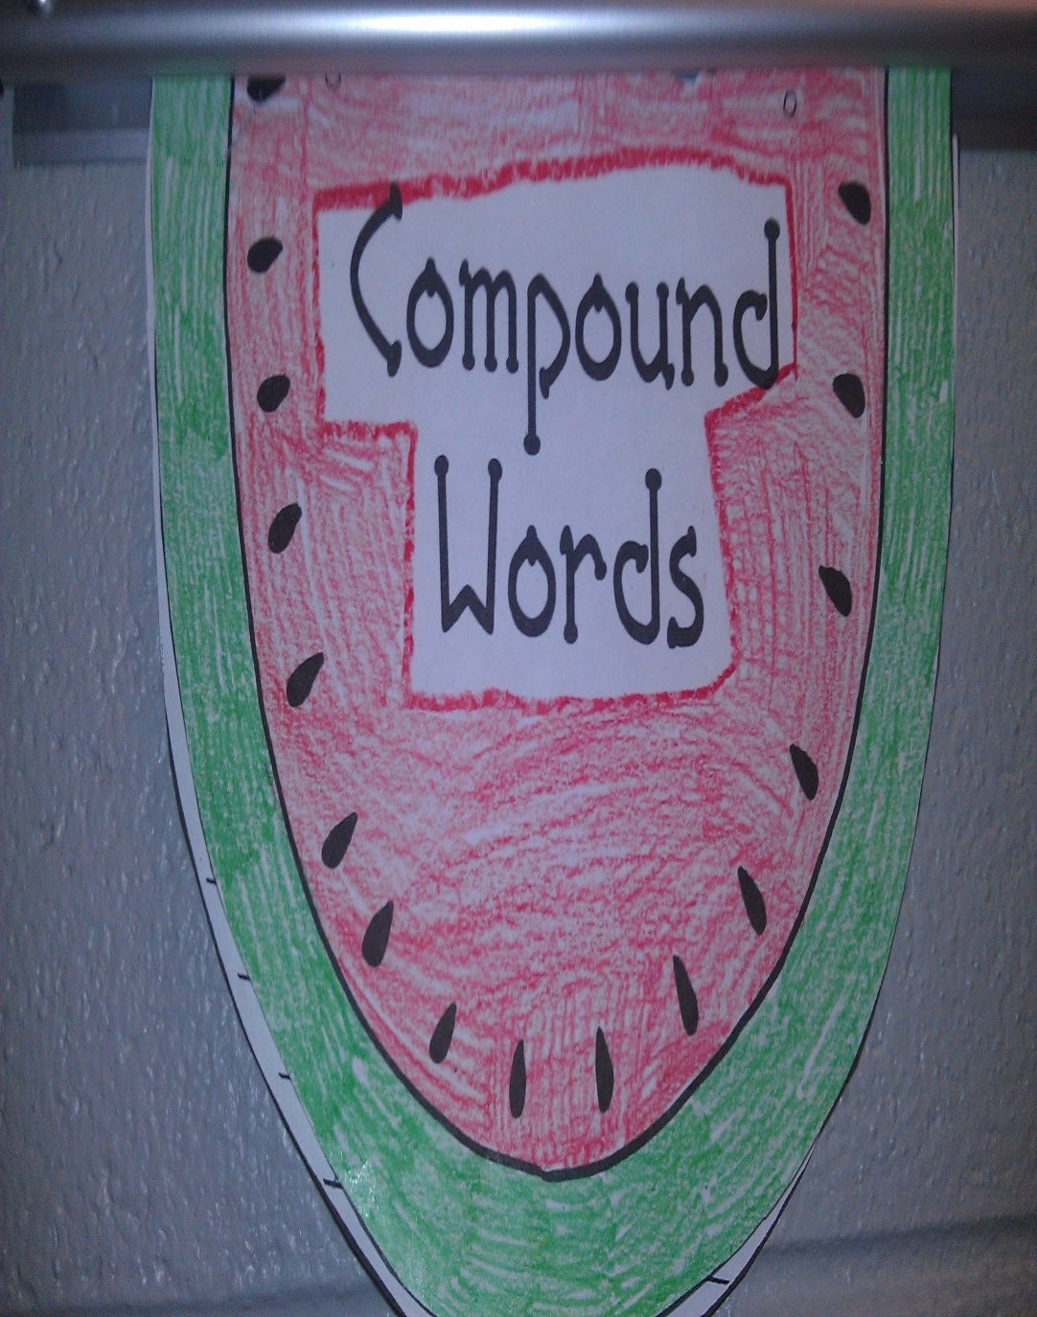
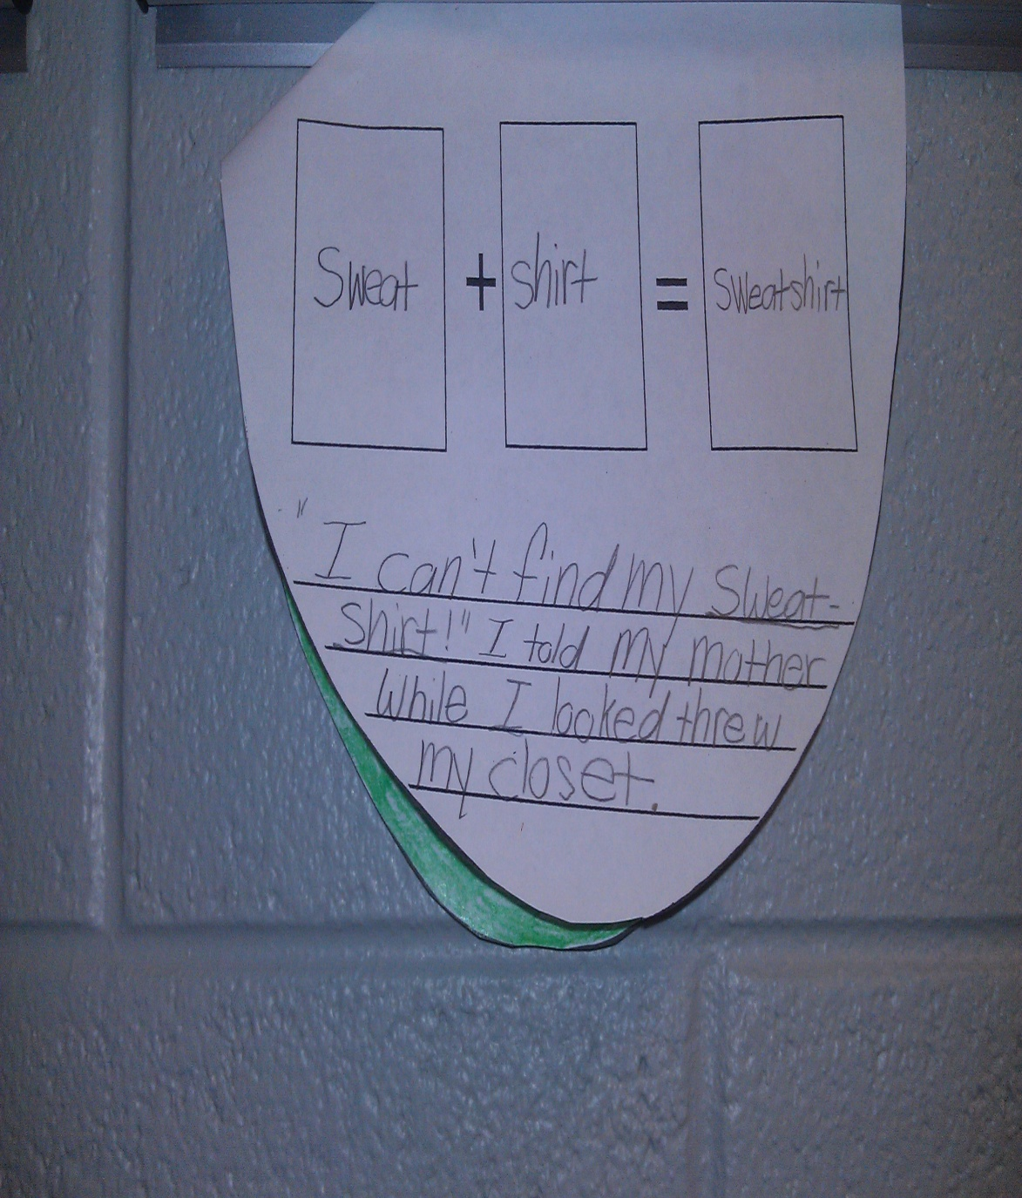

Slide 26
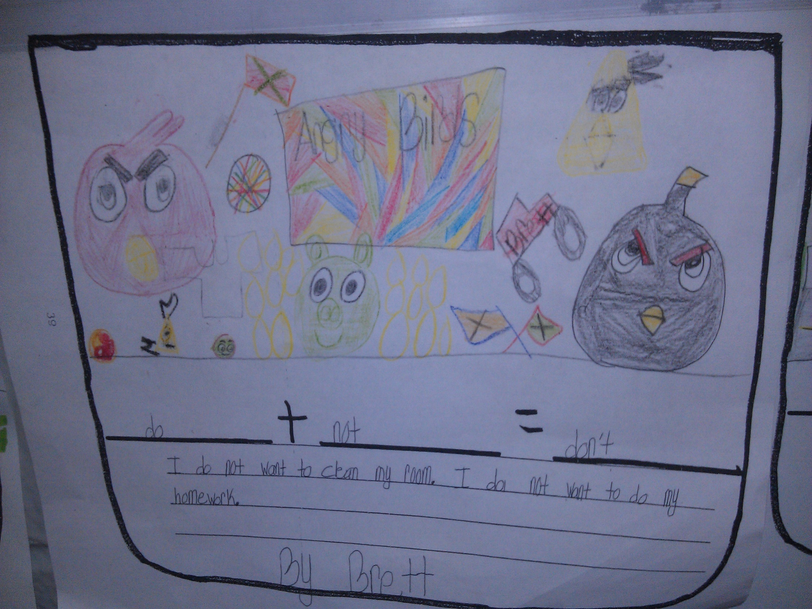

Slide 27
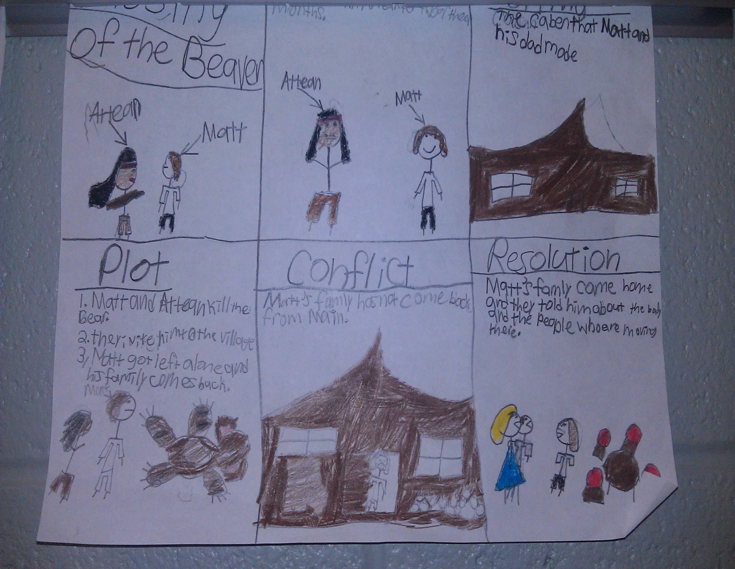

Slide 28
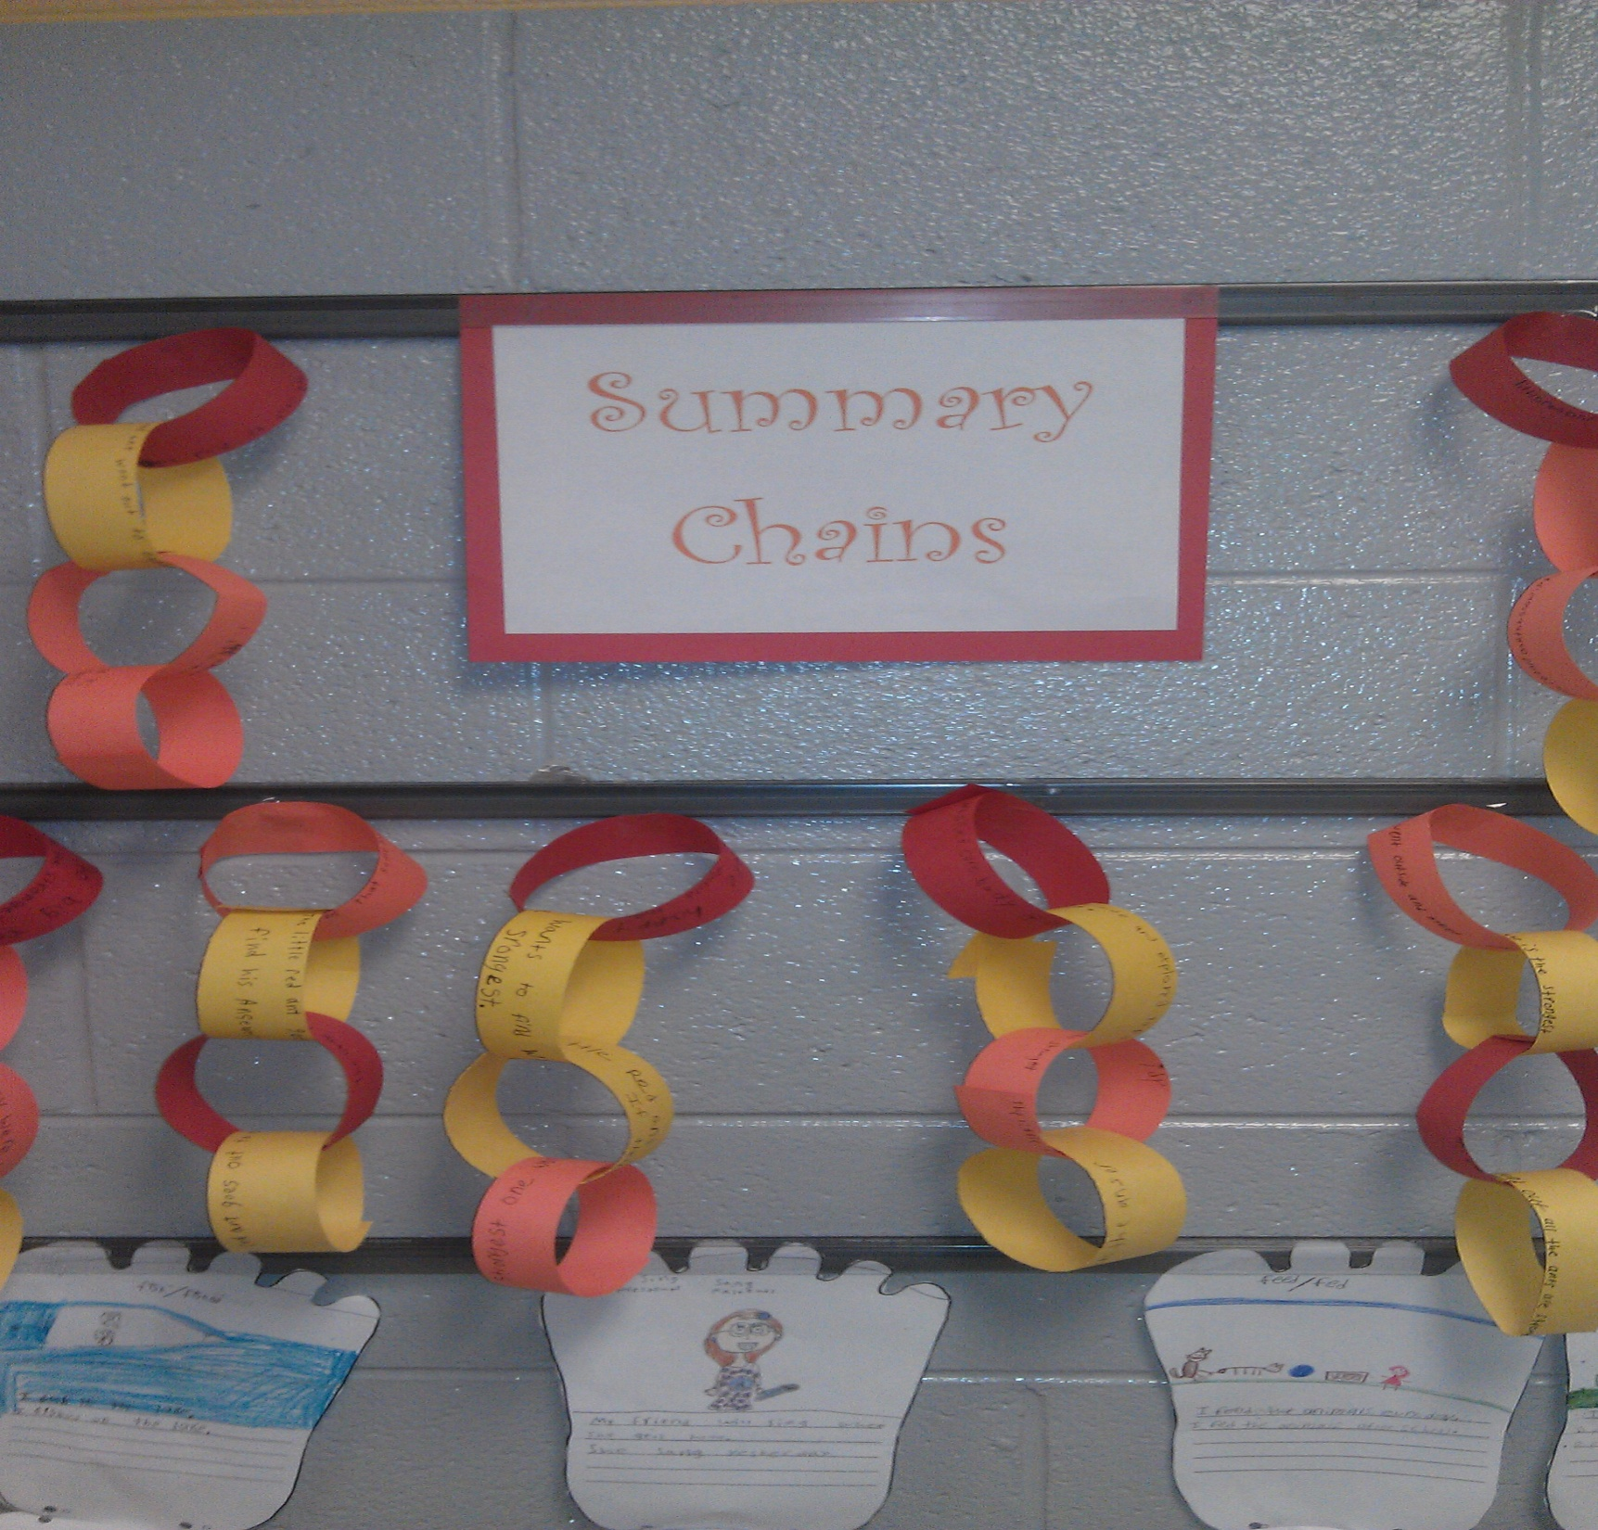

Slide 29
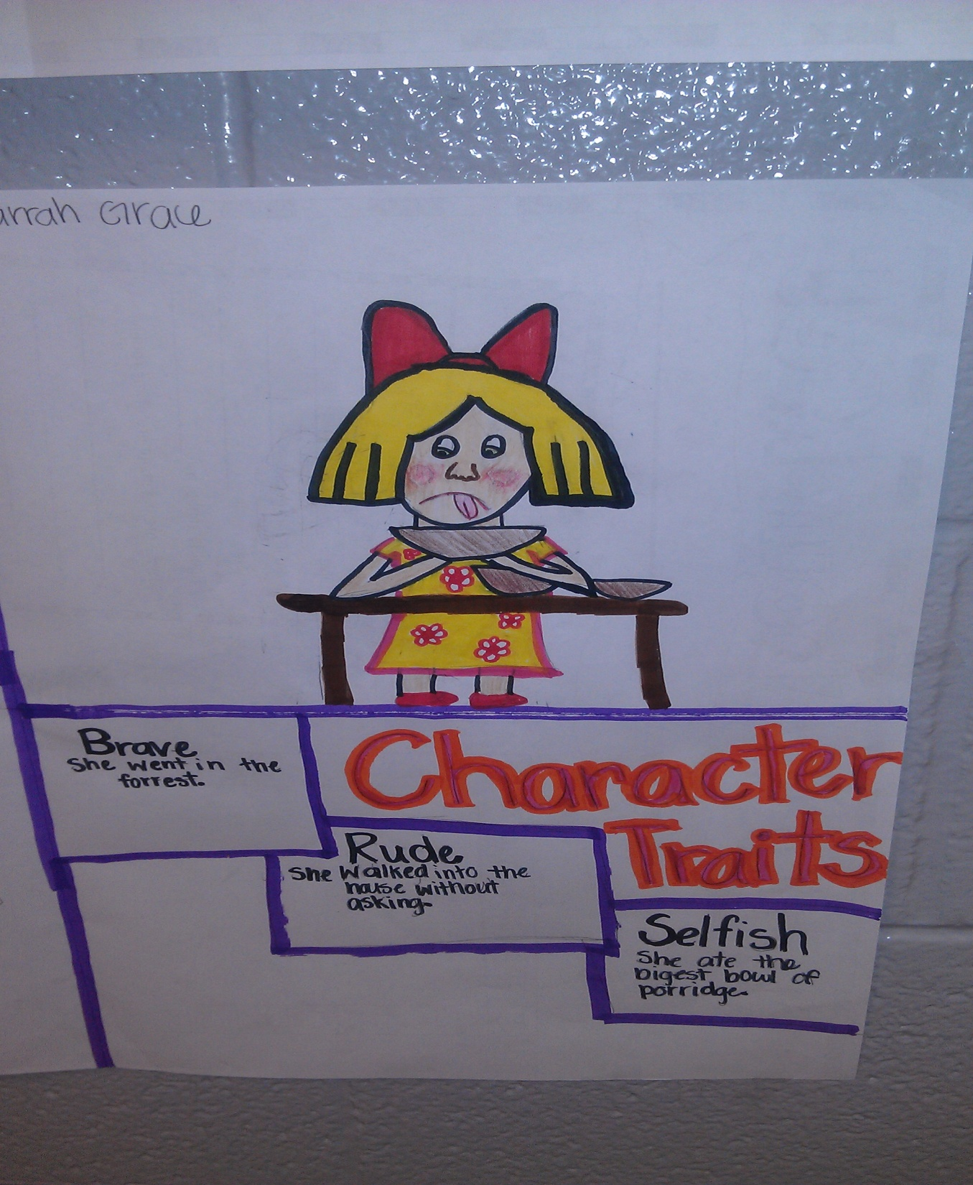

Slide 30
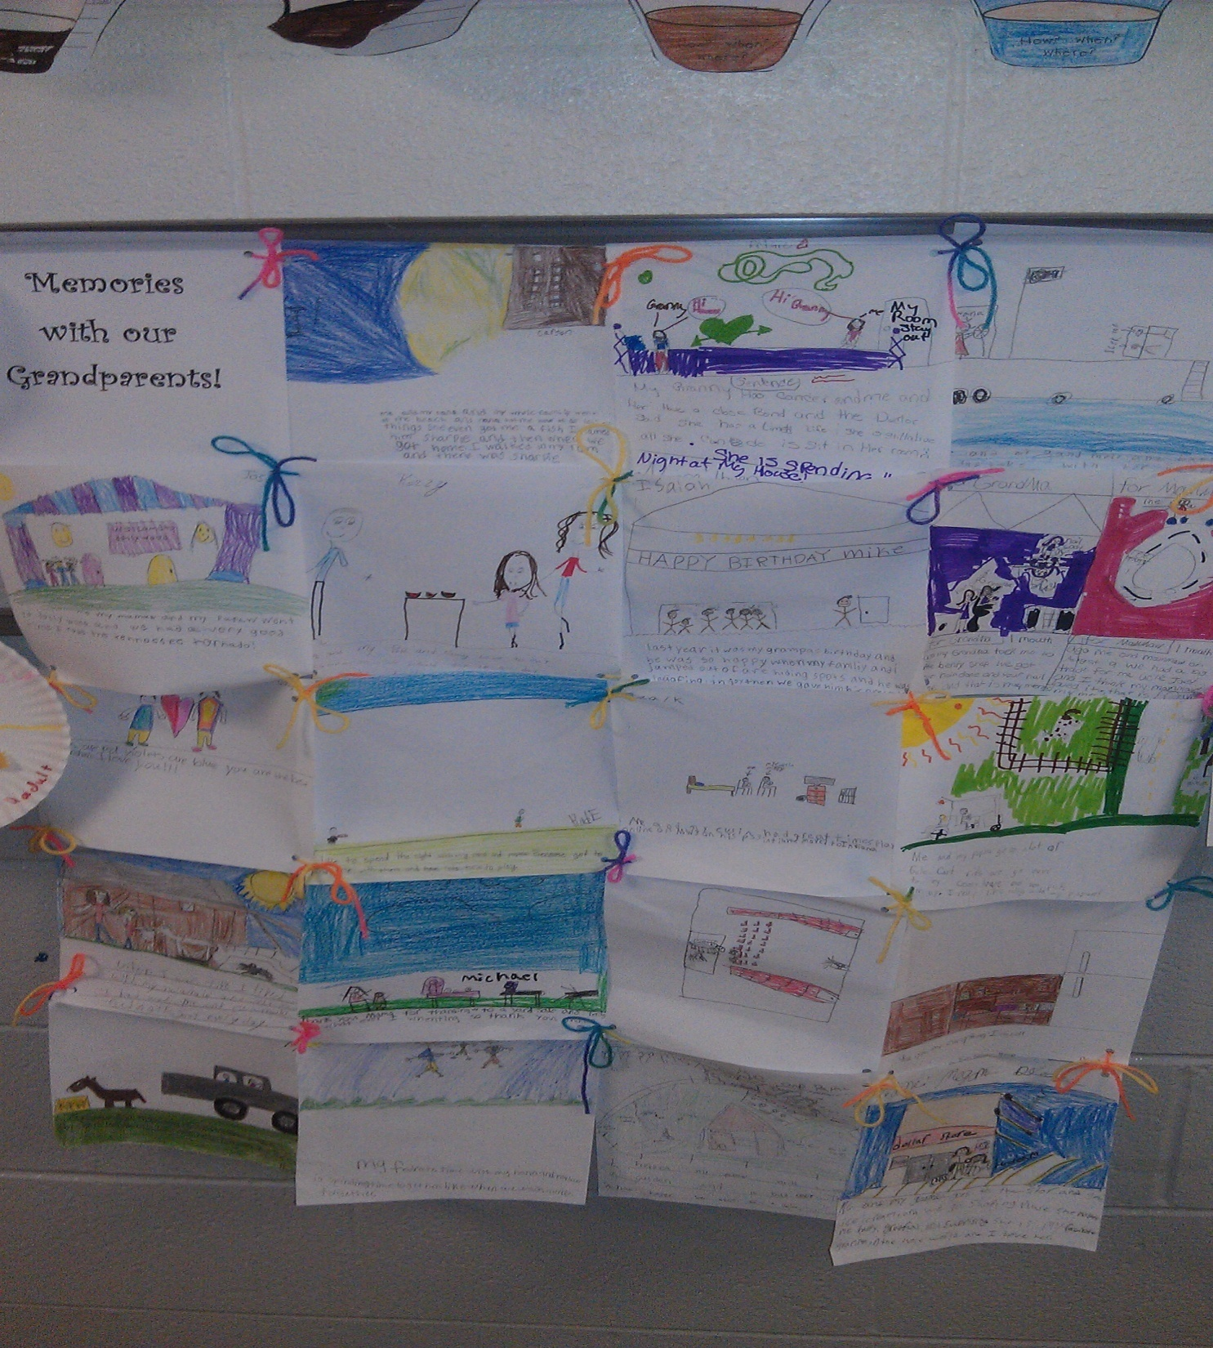

Slide 31
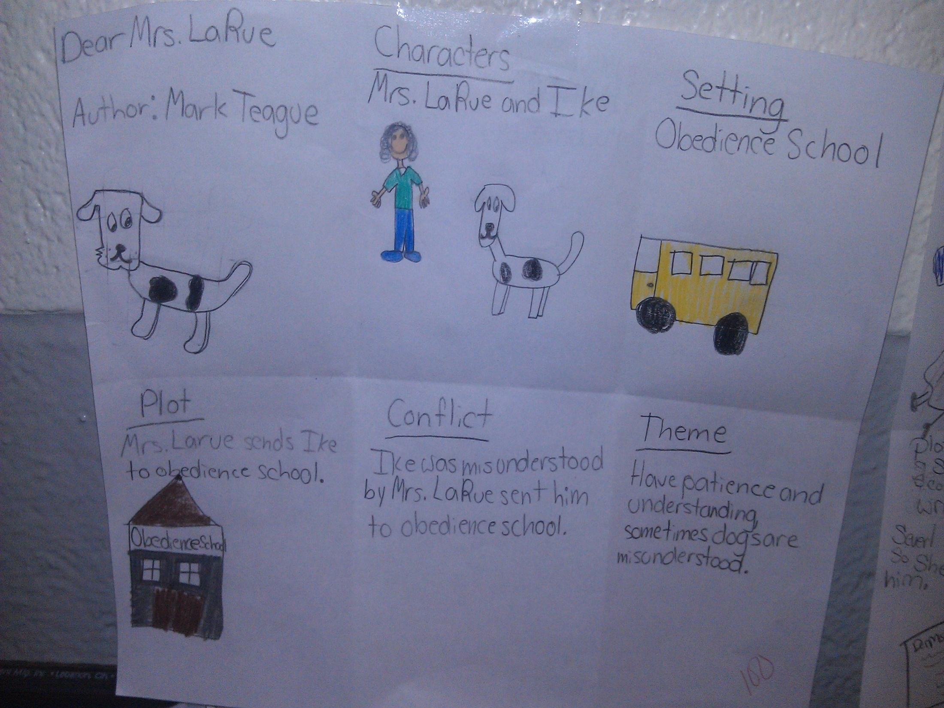

Slide 32
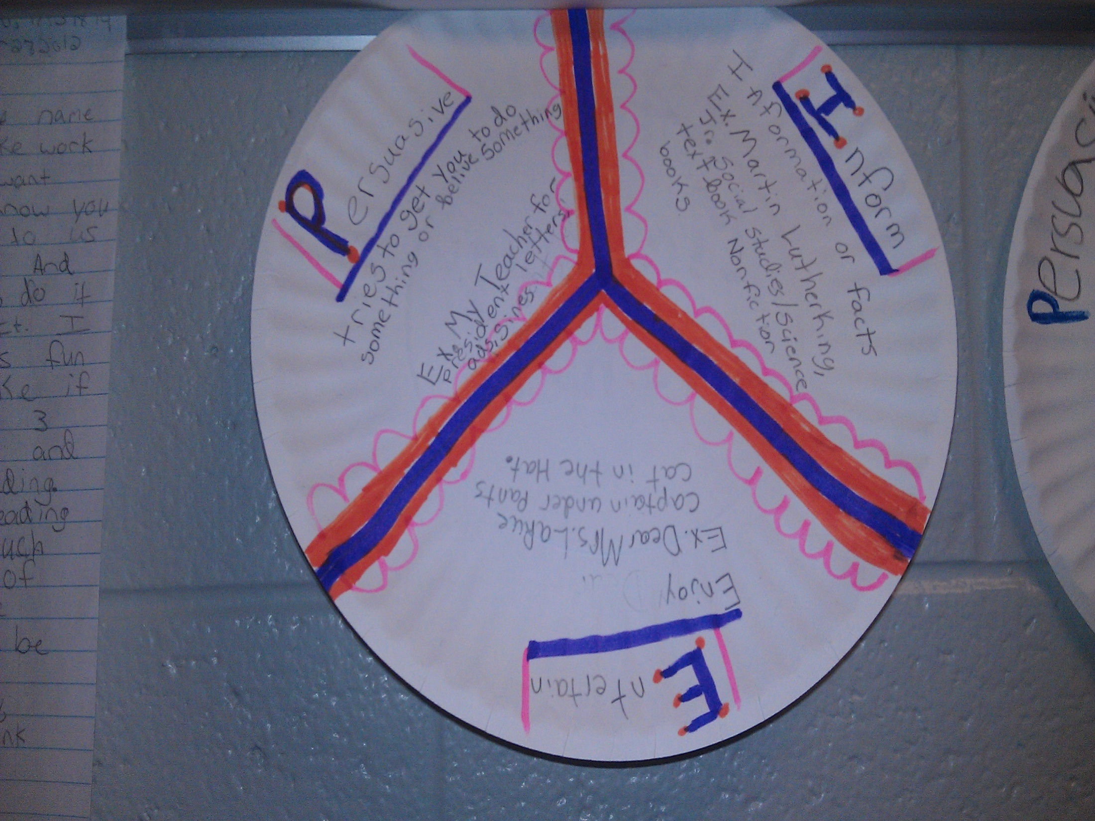

Slide 33
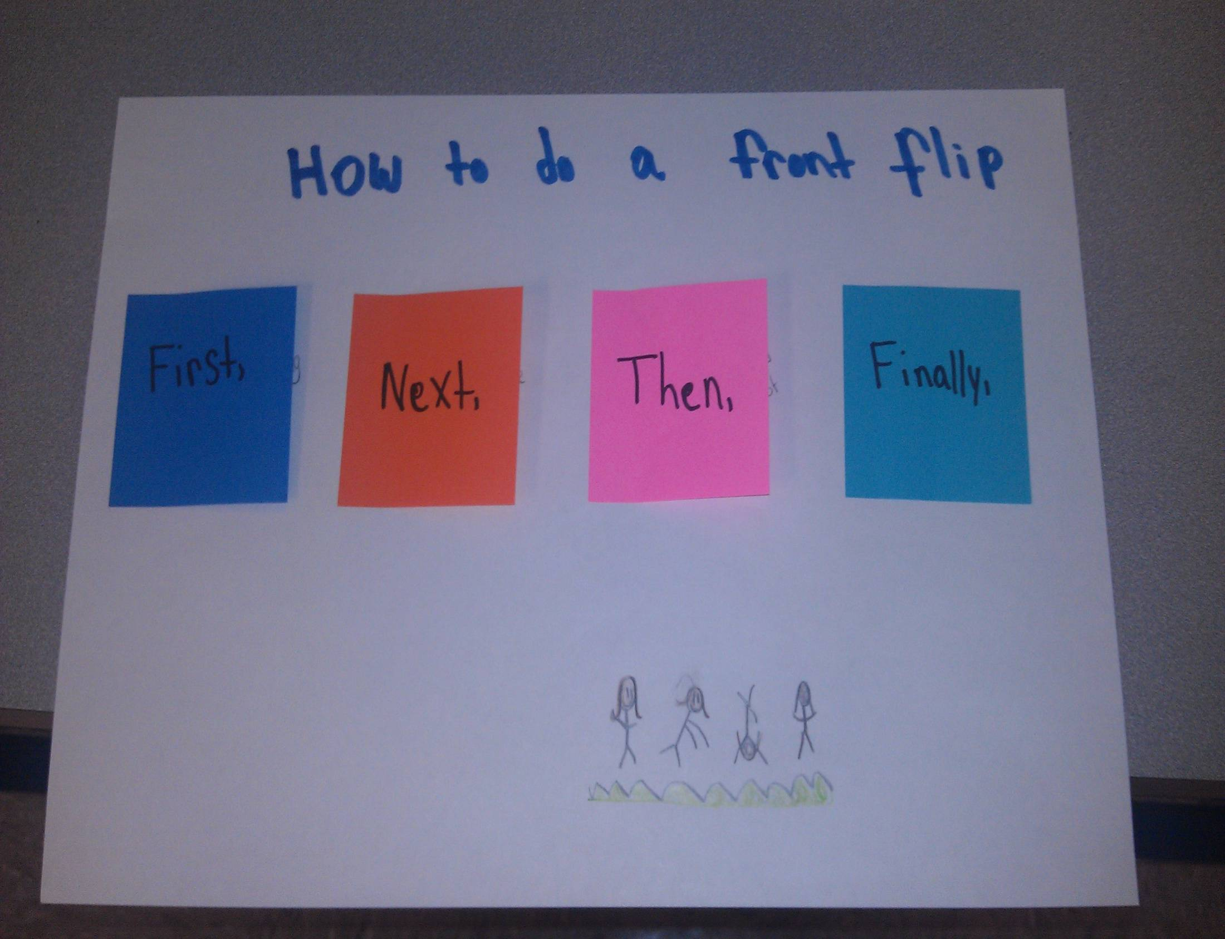

Slide 35
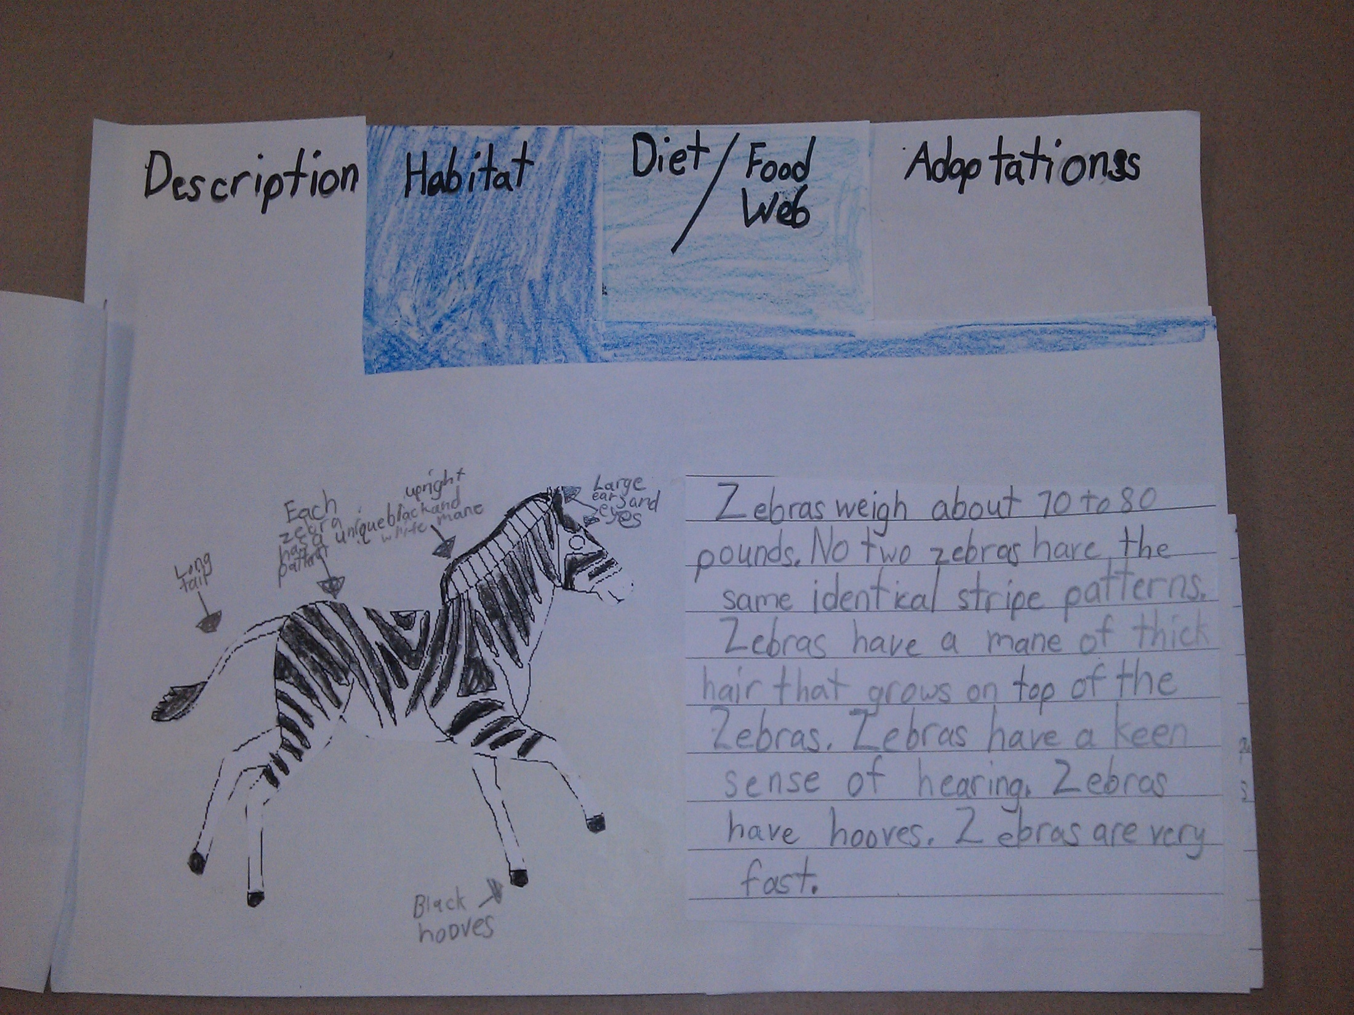

Slide 36
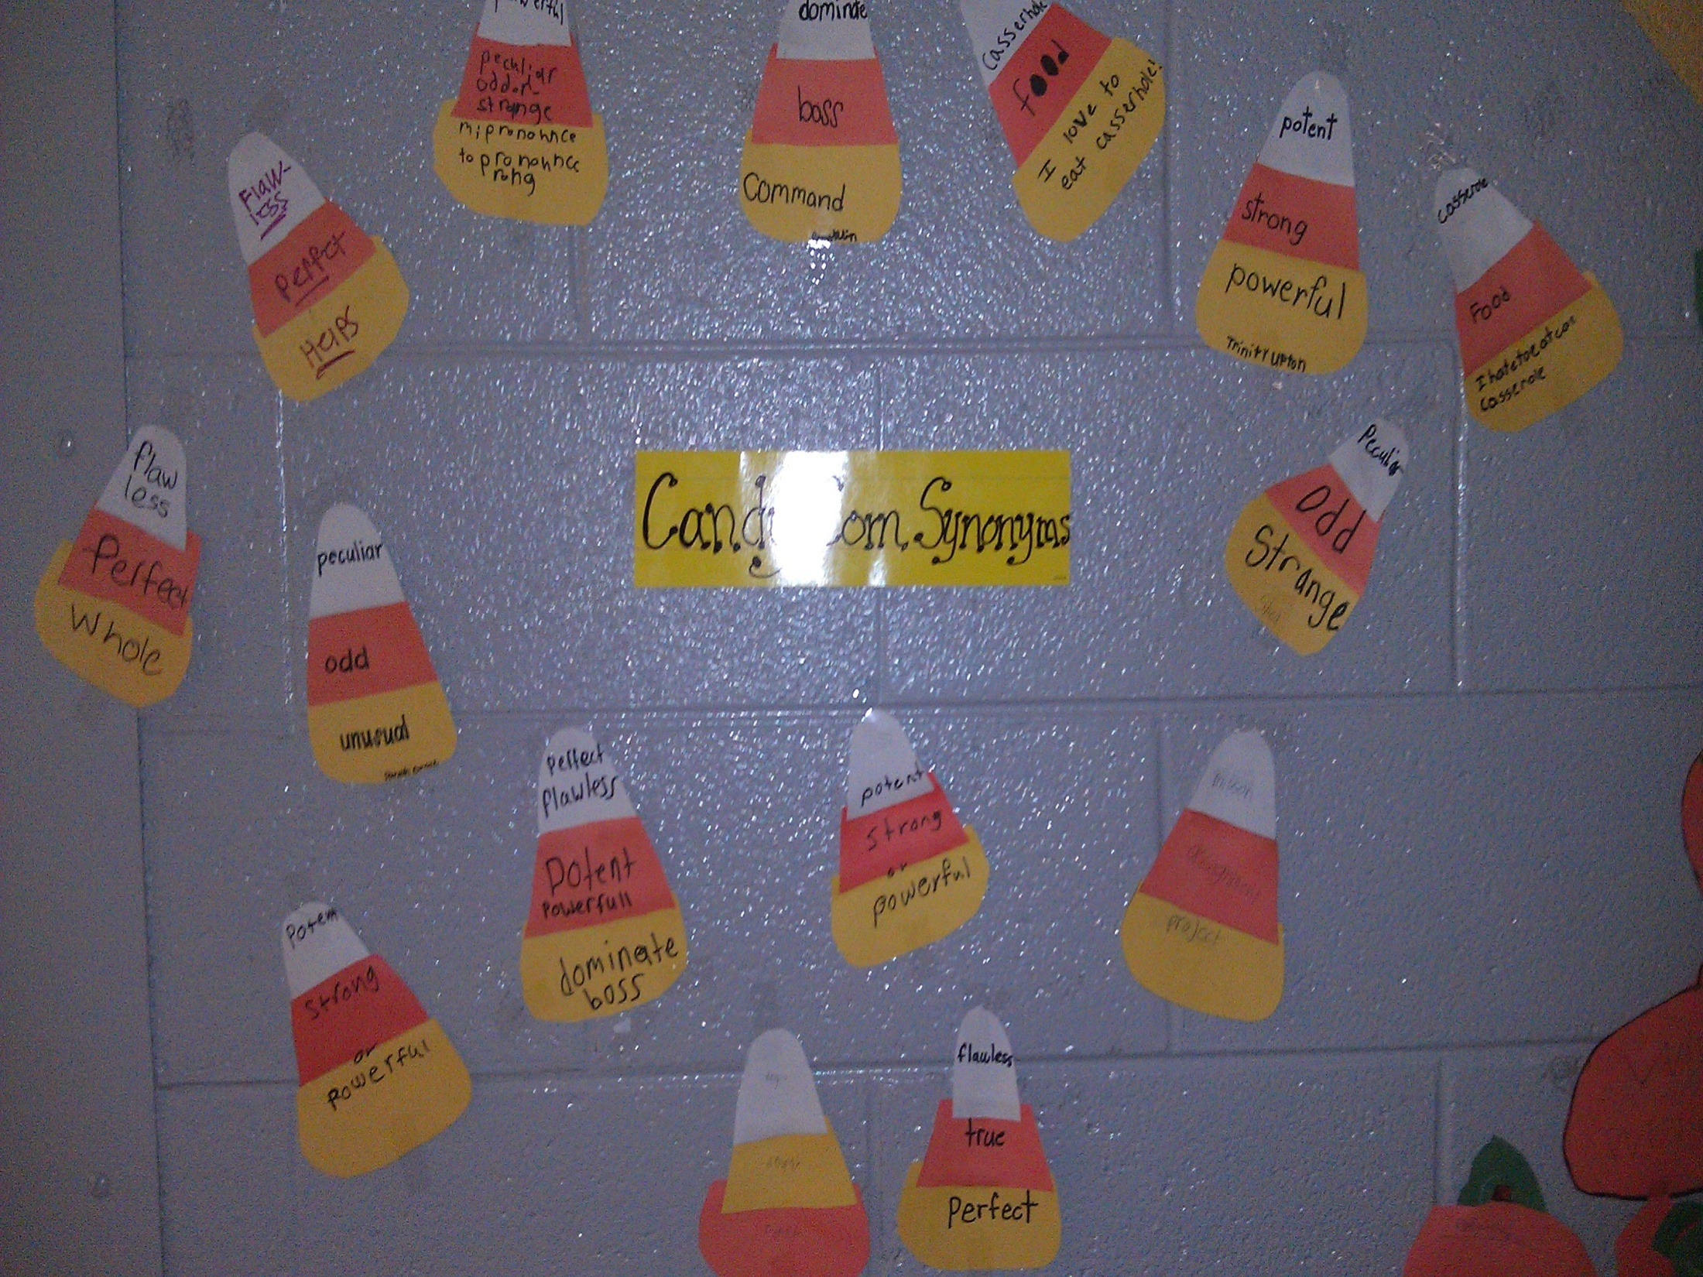

Slide 37
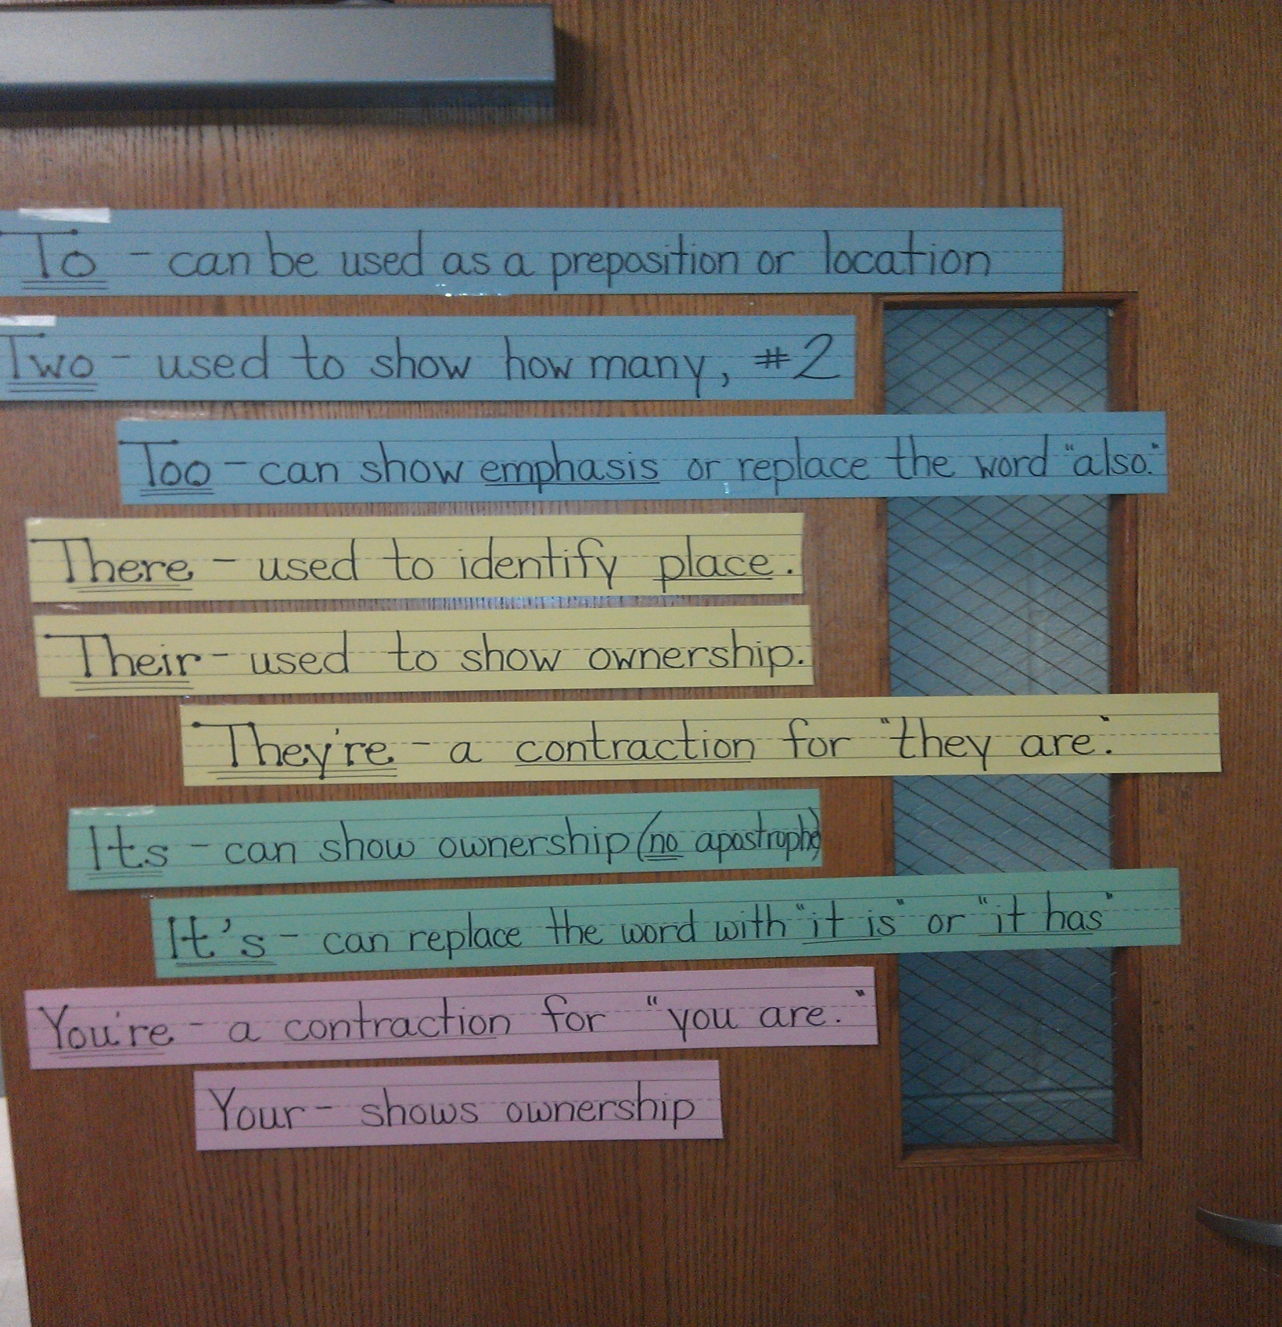

Slide 38
How Do We Make Our Teaching Stick?

Slide 39
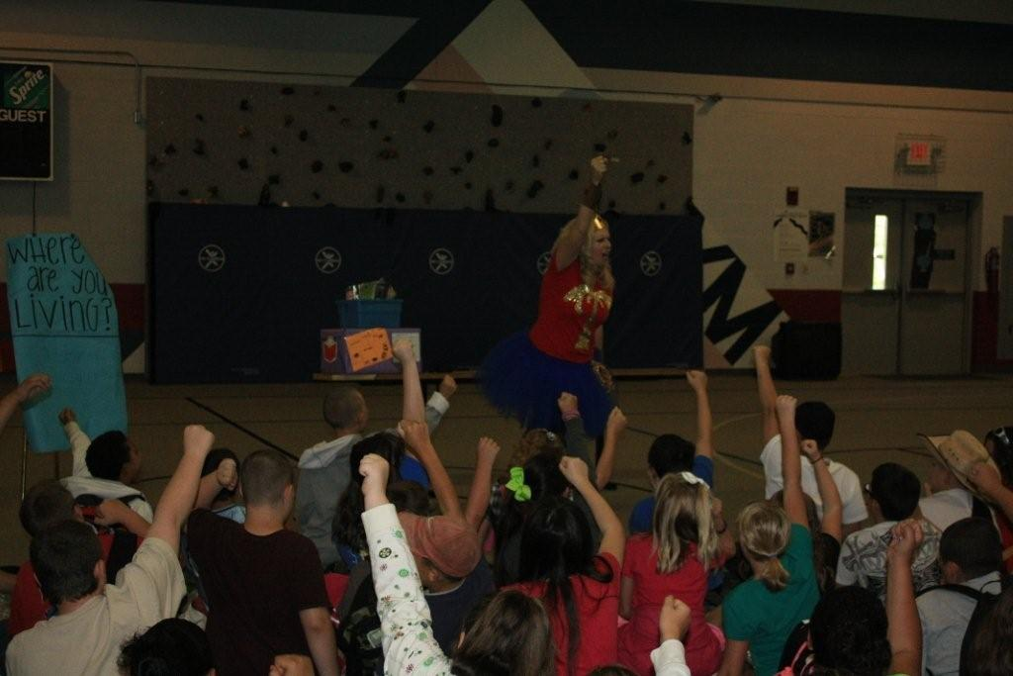
MANTRA
We Are a SUPER SCHOOL!
With SUPER STUDENTS!
Staying SUPER FOCUSED!

Slide 40
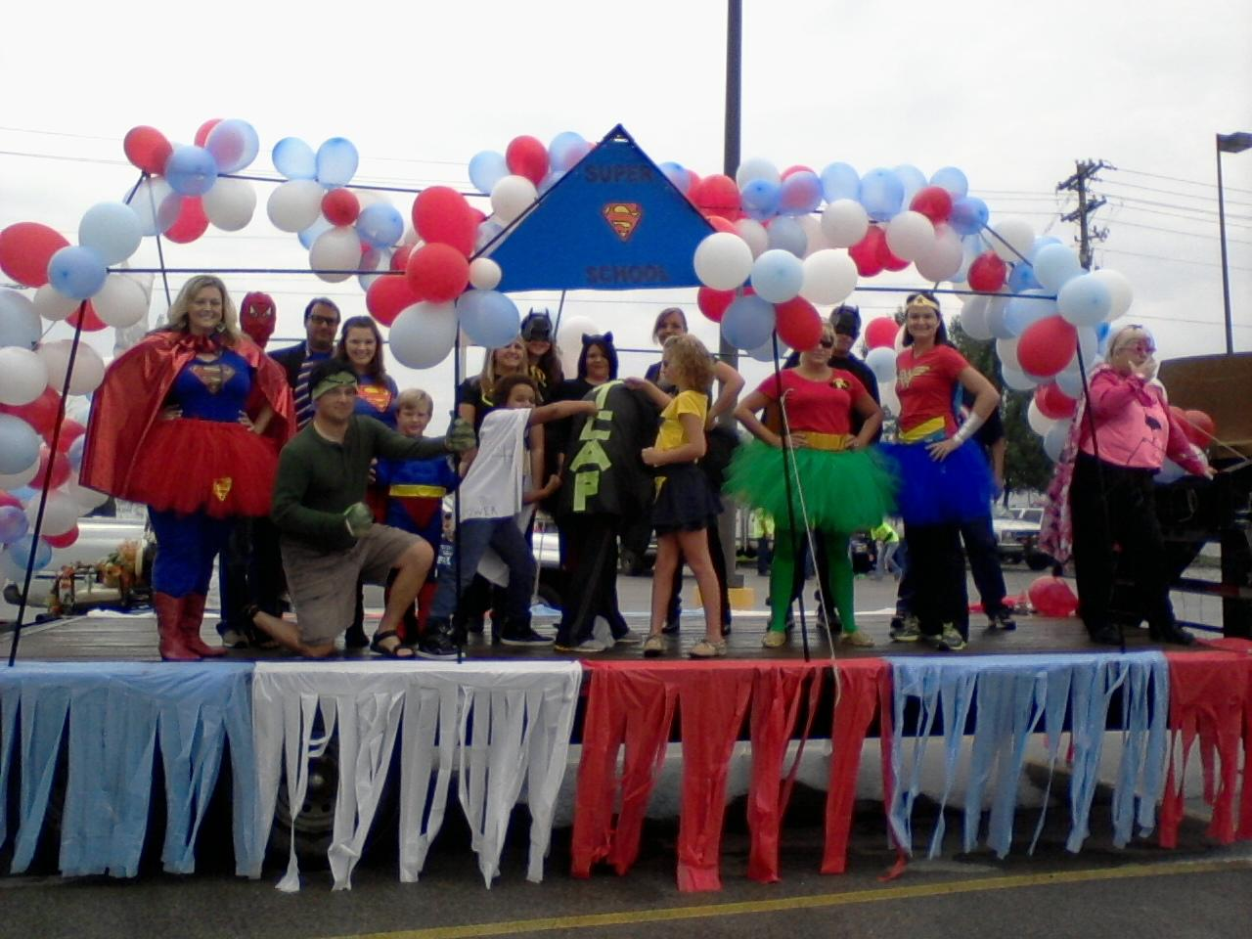
Super School

Slide 41
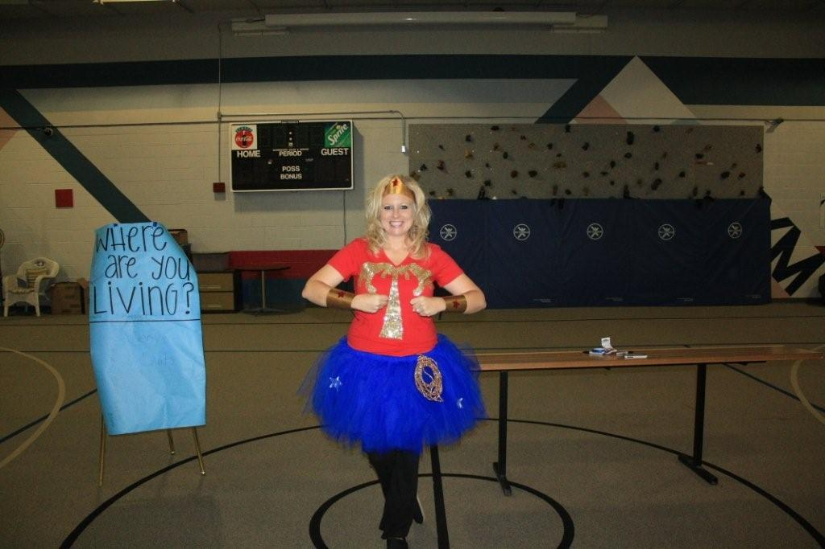
Living Above the Line
Where Are You Living?
_____________________________________

Slide 42
Whole Brain Management
Class, Class, Class…
Echo…
Yes, Yes, Yes….
OH…. CLA…SS
Echo…
OH…. YE…..S
Teaches Students to really focus and listen when the teacher speaks.

Slide 43
Blitz
Interactive Intervention That Makes a Difference
What is Blitz?
How are students grouped?
Who teaches what?
What types of lessons occur during blitz?

Slide 44
Whole Brain Instruction
Songs
Skits
Chants
Media
Field Experience
Dr. Marcia Tate “Worksheets Don’t Grow Dendrites”

Slide 45
Adverbs

Slide 46
Prepositions

Slide 47
Engaging Hooks
Cupid Shuffle- sequence
“Forest Gump” Clip- Predicting- QVCIPC
“Up” Clip- Flow and Irrelevant Sentences
“Lion King” clip- Foreshadowing
TV411- Summary
Recorded horse trainer breaking a horse- inferences
Career day- Inferences and Drawing Conclusions

Slide 48
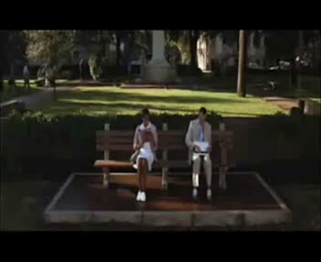
Forrest Gump

Slide 49
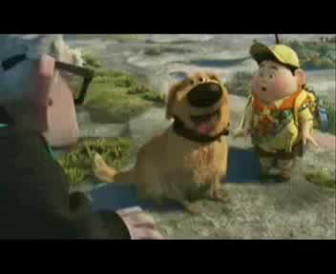
Flow and Irrelevant Sentences

Slide 50
Group Roles
Leader
Recorder/ Organizer
Reporter
Time Keeper/ Maintenance
Information Gatherer

Slide 51
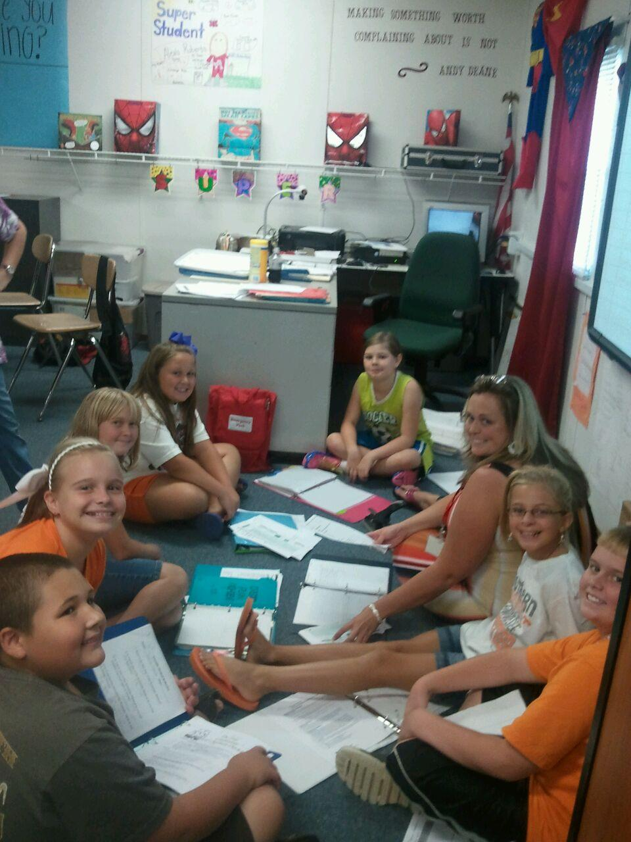

Slide 52
Teach Like Ya Mean It!
Each lesson must have a meaning and purpose for students.
EVERYTHING is on Purpose.
From the Posters I put up, to the way I present the material.

Slide 53
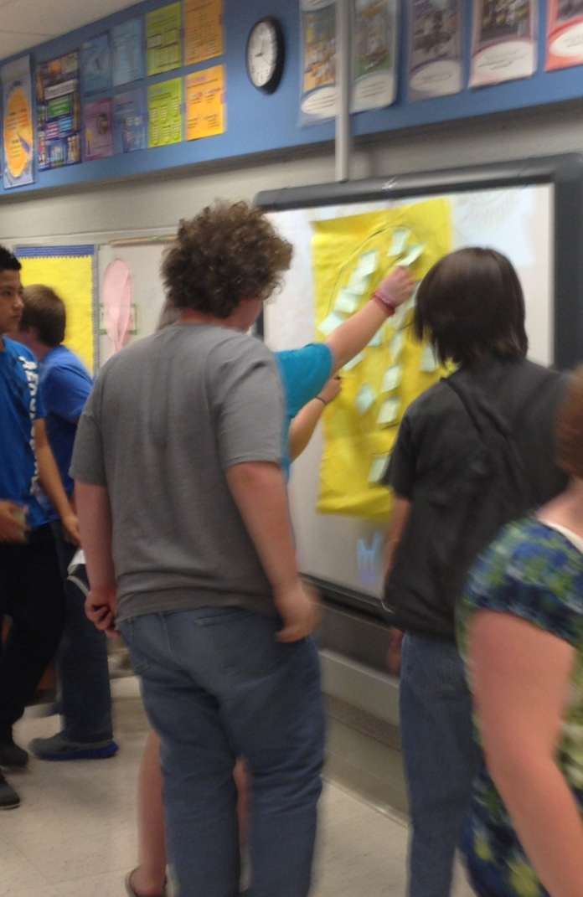
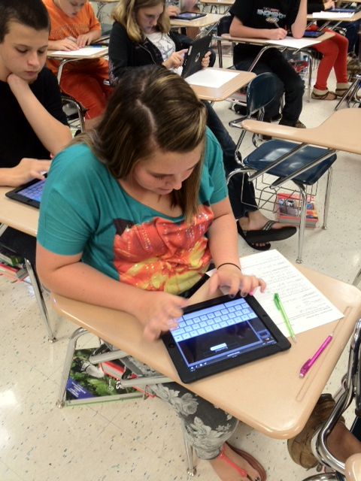
Interactive Doesn’t have to Mean Technology (but it can ☺)

Slide 54
iPad Apps
Pages-paid
Keynote-paid
Pics Collage
Comic Head
Tour Wrist
Skitch
Show Me
Mad Libs
Flash Cards
Image chef
Idioms
Garfield Facts and Opinion
Garfield Forms of Media
Sock Puppet
Poster Artist
Mematic

Slide 55
Interactive Notebooks
King

Slide 56
Purpose
To enable you to be creative, independent and a reflective thinker & writer throughout the year.
Interactive Notebooks (IN) will be used for class notes as well as for other activities where you will be asked to express your own ideas and process and /or apply the information and skills learned in the class

Slide 57
Right Pages=Input (Teacher Involvement)
Lecture notes
Procedural notes
Vocabulary
Comprehension Questions
Reading Notes
Movie, Video notes
Odd Page Numbers
Assignments
Name, Date, Period
Title of Lesson/Unit
Worksheets
Table of Contents

Slide 58
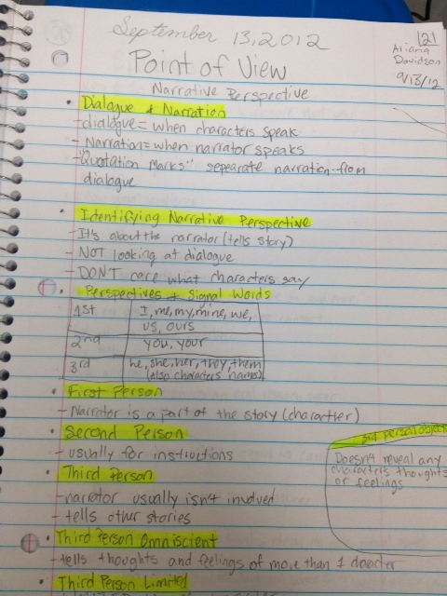
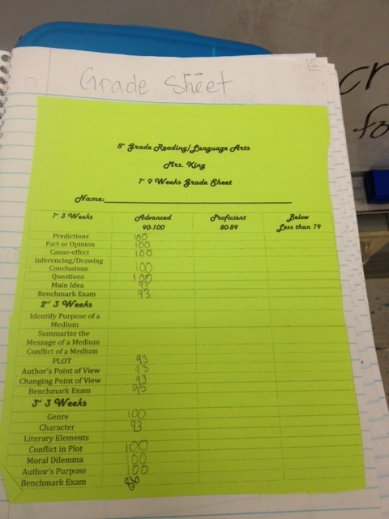
Right Hand Side
Notes
Grade sheet

Slide 59
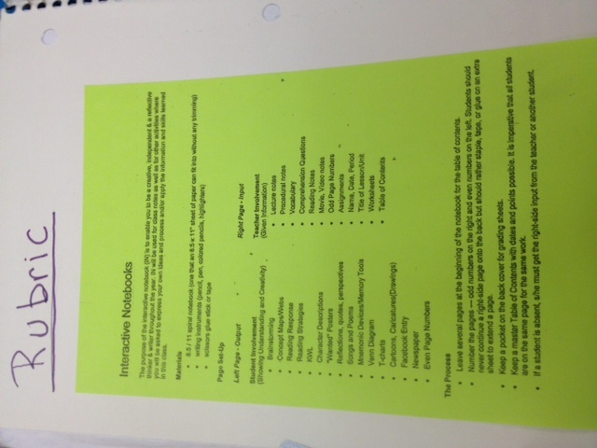
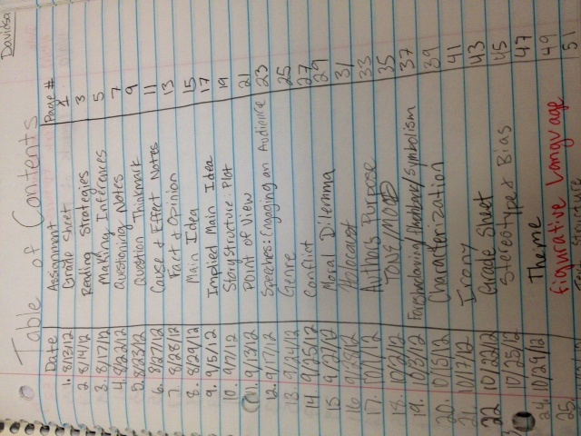
Rubric (Front Cover)
Table of contents

Slide 60
The Left Pages = OUTPUT (Student’s work)
(Showing Understanding and Creativity)
Brainstorming
Concept Maps/Webs
Reading Response
Reading Strategies
KWL
Character Descriptions
"Wanted" Posters
Reflections, quotes, perspectives
Songs and Poems
Mnemonic Devices/Memory Tools
Venn Diagram
T-charts
Cartoons, Caricatures(Drawings)
Facebook Entry
Newspaper
Even Page Numbers

Slide 61
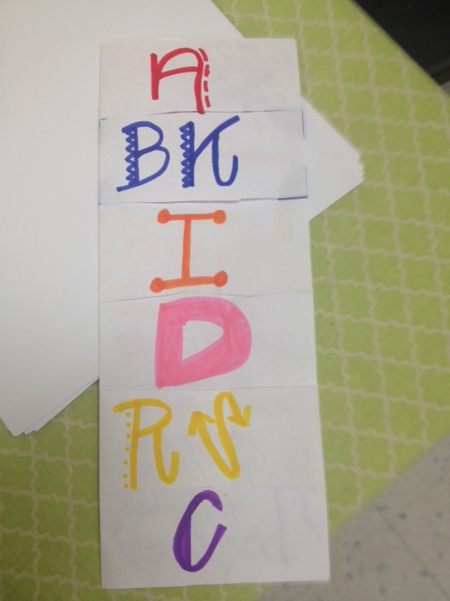
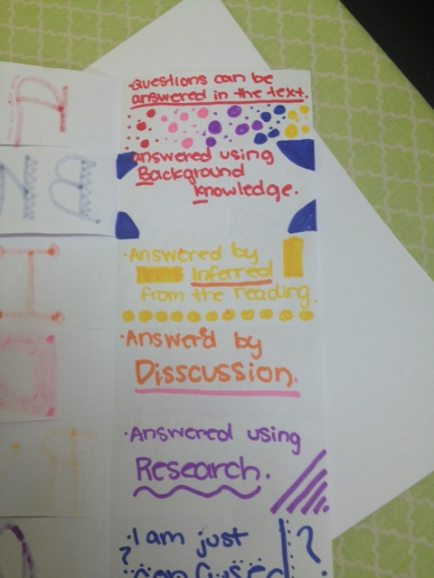
Foldable Examples/Left Hand Side

Slide 62
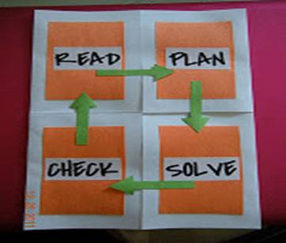
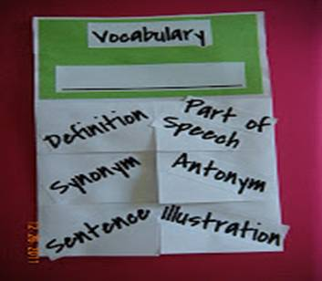

Slide 63
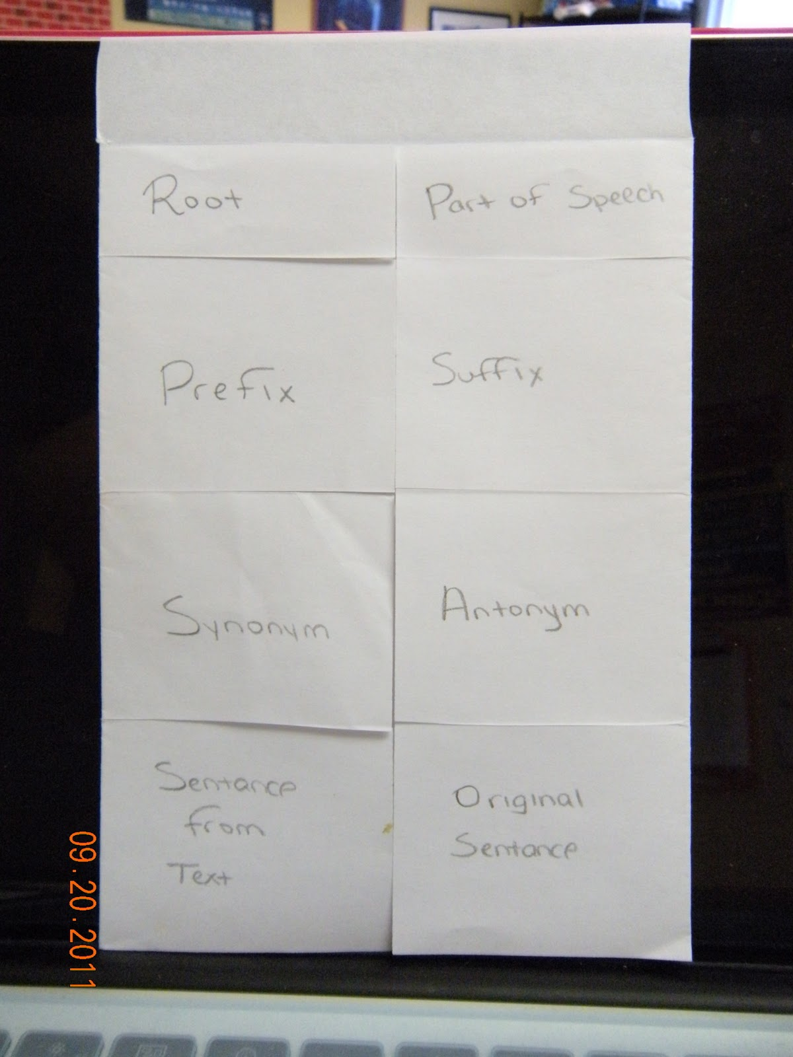
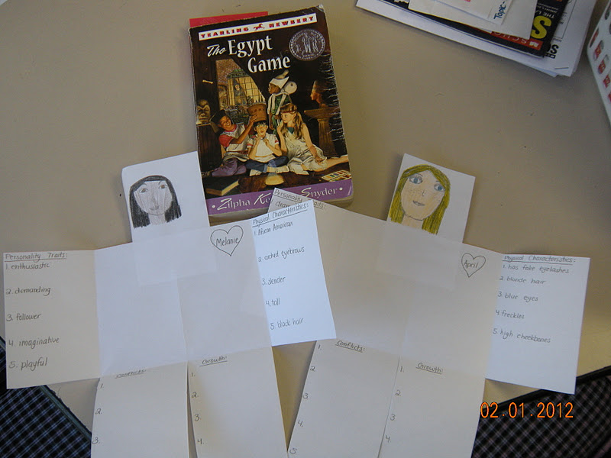
Foldables

Slide 64
“Hippo”campus Books courtesy of Quantum Training
Students were not retaining material
Refusal to study
Learned in a Quantum Training In-service about storage of Info
We can retain information better if we “fed our Hippo” right before we went to bed.
What we did-

Slide 65
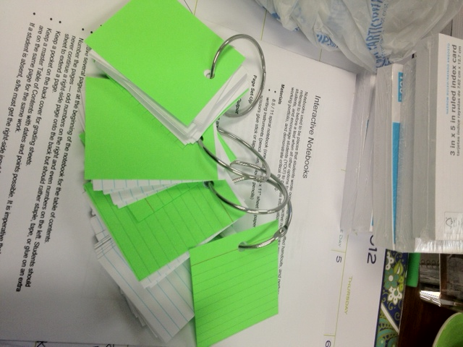
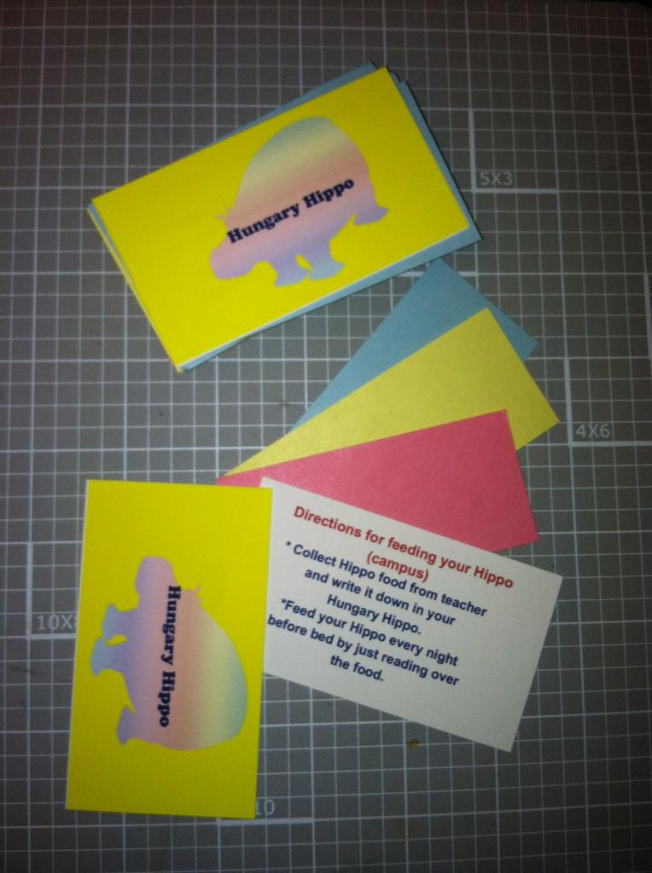
HIPPOcampus Books

Slide 66
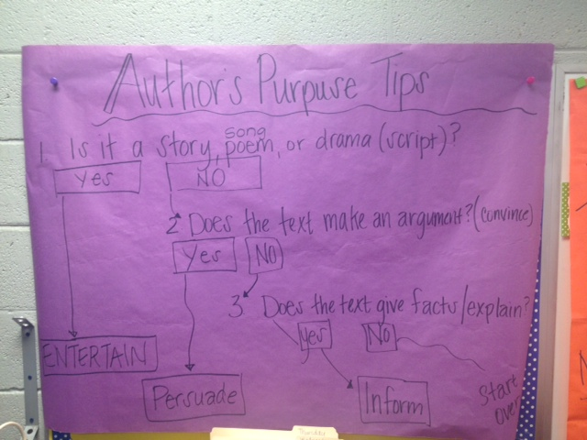
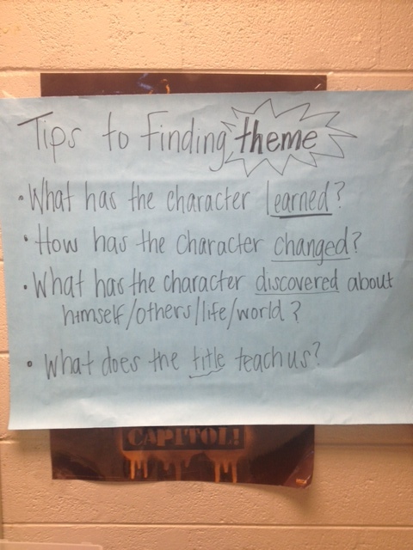
Anchor Charts-Gallery Walks- Hippo Food

Slide 67
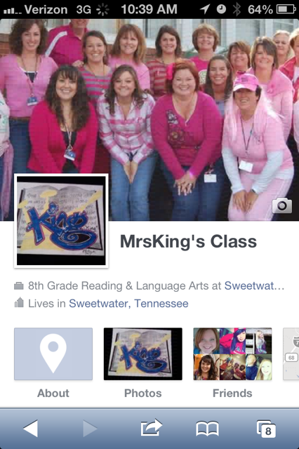
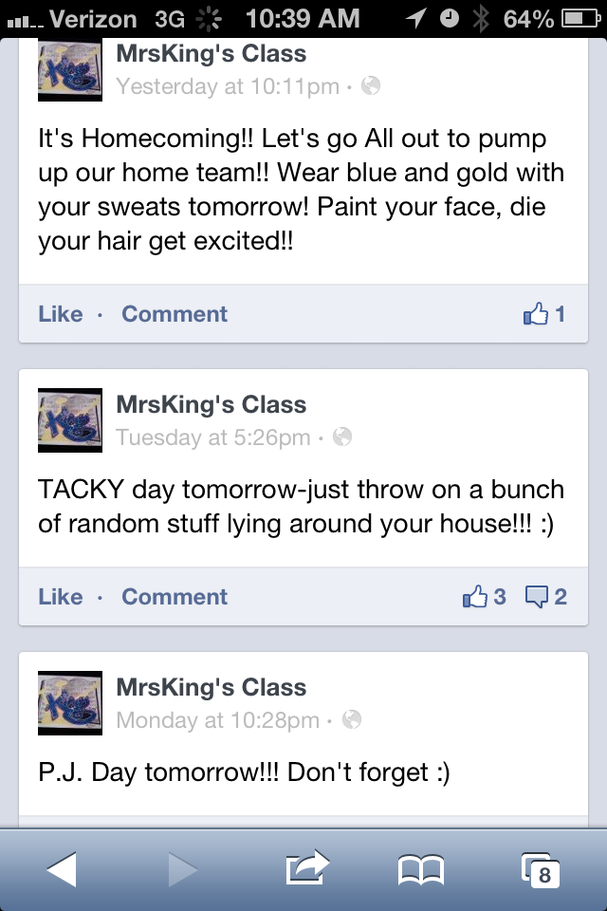
The Power of Social Media

Slide 68
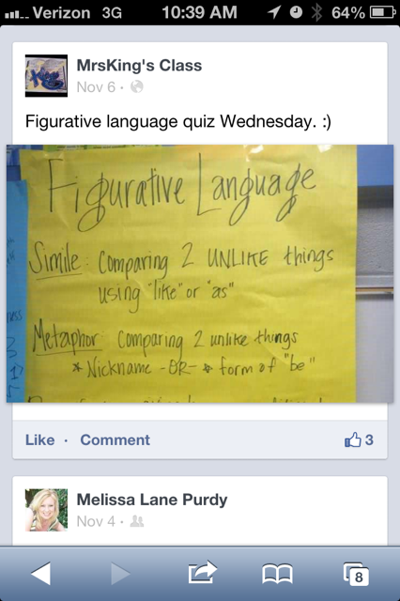
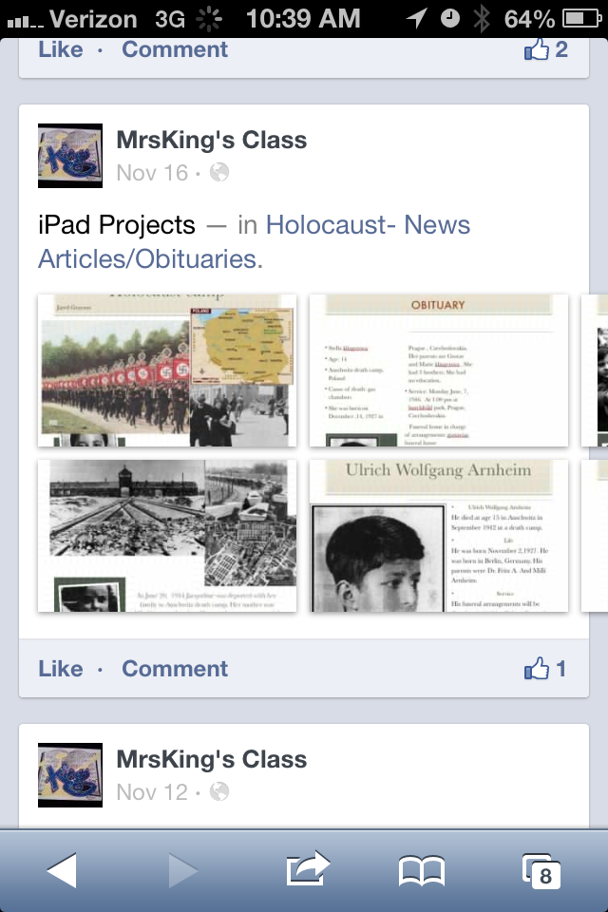

Slide 69
All Areas Working Together
Science- Big Book of Science
Social Studies
Related Arts
Students

Slide 70
“Just do what must be done. This may not be happiness, but it is greatness.”
George Bernard Shaw

Slide 71
Contact
Melissa.purdy@scstn.net
Julia.king@scstn.net * ppt
Tonya.wallis@scstn.net
Karen.sadikoff@scstn.net
www.sweetwatercityschools.com

